Slide 1
Learning Event #2: Webinar
Help is on the Way!: Ways the Workforce System Can Support RA
Mark Genua, Director, Jobs for the Future | Shamara P. Bownes, Senior Manager, Jobs for the Future
NJ A-TAC Community of Practice | Tuesday, February 27, 2024 | 11:00am – 12:00pm ET

Slide 2
Learning Event #2: Webinar Agenda
Welcome – Shamara P. Bownes, Senior Manager, Jobs for the Future
Agenda Overview – Shamara P. Bownes, Senior Manager, Jobs for the Future
Session Topic Overview/Presenter Introductions – Mark Genua, Director, Jobs for the Future
Help is on the Way!: Ways the Workforce System Can Support RA – Melissa Aguilar-Southard, Project Director/Senior SME & Alan Dodkowitz, SME, Safal Partners/USDOL RA TA Center of Excellence on Strategic Partnerships & Systems Alignment
Q&A/Discussion – All
Reminders/Conclusion – Shamara P. Bownes, Senior Manager, Jobs for the Future

Slide 3
Learning Event #2: Webinar Topic
Help is on the Way!: Ways the Workforce System Can Support RA
Alan Dodkowitz, SME, Safal Partners/USDOL RA TA Center of Excellence on Strategic Partnership & Systems Alignment
Melissa Aguilar-Southard, Project Director/Senior SME, Safal Partners/USDOL RA TA Center of Excellence on Strategic Partnerships & Systems Alignment

Slide 4
Help is on the Way! Ways the Workforce System Can Support Registered Apprenticeship
© 2024 Safal Partners

Slide 5
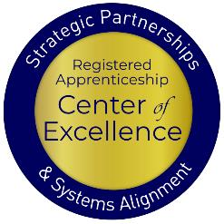
Who We Are
USDOL Registered Apprenticeship (RA) Technical Assistance (TA) Center of Excellence on Strategic Partnerships and System Alignment
We provide no-cost TA services, products aimed at:
Accelerating RA strategic partnerships
Increasing alignment between apprenticeship and workforce and education systems ​
Increasing use of RAP model in WIOA
Boosting WIOA funded support for RA through co-enrollment
Increasing workforce system participation in RA
Doubling current statewide WIOA participation in RA
© 2024 Safal Partners

Slide 6
How's Your RA Knowledge?
Basic
I know what it means, but I don’t know how to utilize it and don't have significant experience with it
Intermediate
I understand RA, I've had experience with RA in some capacity, and I feel comfortable educating internal and external stakeholders about it.
Expert
I have extensive knowledge and relevant experience:
developing programs
accessing multiple sources of funding;
convening stakeholders ;
adding programs to the ETPL;
recruiting apprentices or employers.
© 2024 Safal Partners

Slide 7
What is Registered Apprenticeship?
Registered Apprenticeship is a proven, customizable, and structured model to find and train diverse new talent as well as upskill current workers in critical occupations.

Slide 8
Five Core Components of RA
Employer Involvement
Structured On-the-Job Learning (OJL)
Related Instruction (RI)
Rewards for
Skill Gains
National Occupational Credential
© 2024 Safal Partners

Slide 9
Key Organizational Apprenticeship Roles
Sponsor
RI Provider
Employer
Partner
An organization that agrees to operate an apprenticeship program and in whose name the program is registered.
Entity that provides instruction to apprentices in the designated occupation’s core knowledge, skills, and abilities.
Hires and provides paid OJL for apprentices under
supervision of a designated mentor who is a skilled professional in
that occupation.
Organizations
committed to assisting RA programs. They can play one or more roles.
© 2024 Safal Partners

Slide 10
Current Gaps in New Jersey’s Workforce Alignment
© 2024 Safal Partners

Slide 11
Co-Enrollment is Low
Only 270 individuals co-enrolled in WIOA and Registered Apprenticeship Programs across three WIBS. (Box 931 checked - PIRL)
Only 25 individuals receiving RA training across four different WIBs. (Box 1303 checked – PIRL)
© 2024 Safal Partners

Slide 12
But Trenton Stands Out…
266 individuals co-enrolled in WIOA and Registered Apprenticeship Programs in Trenton out of 1,223 individuals served. (Box 931 checked - PIRL)
That’s nearly 22% of eligible individuals co-enrolled!
© 2024 Safal Partners

Slide 13
There’s a Chance to Have a Greater Impact
New Jersey served 111,779 individuals in WIOA Title I and II across its WIBs.
If each WIB co-enrolled at the same rate as Trenton… New Jersey could co-enroll 24,312 people annually- nearly 100 times the current number.
© 2024 Safal Partners

Slide 14
How Workforce Boards Can Help
© 2024 Safal Partners

Slide 15
How Workforce Boards Can Help Education Providers
Provide WIOA funding (Individual Training Account (ITA) / Supportive Services) to support RA costs.
Make connections with employers, sponsors.
Host convenings between education and industry.
Provide pipeline of potential students to enroll in programs.
Add programs to the Eligible Training Provider List (ETPL).
Support the development of RI curriculum using labor market information and industry standards.
© 2024 Safal Partners

Slide 16
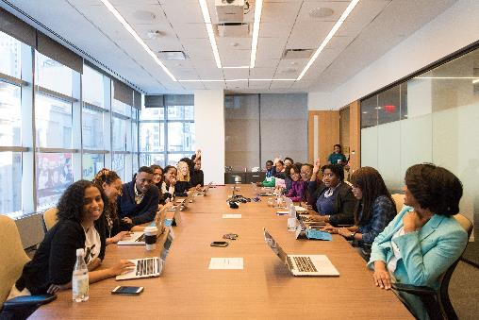
How Workforce Boards Can Help Employers/Sponsors
Provide a pipeline of potential apprentices thru publicizing RA program openings, screening candidates, and provide pre-apprenticeship training.
Provide supportive services to apprentices.
Provide WIOA OJT contract funding to support percentage of apprentice wages.
Build partnerships w/training providers on ETPL for RI; utilize ITAs to pay for all/portion of apprentices' RI costs.
Support registering and implementing RA programs.
Host convenings (job fairs, recruiting events, etc.) to connect potential apprentices and employers
© 2024 Safal Partners

Slide 17
How Workforce Boards Can Help Community-based Organizations
Provide education on RA
Connect potential apprentices with employers
Provide supportive services to apprentices
Connect potential apprentices to other resources available within the community
© 2024 Safal Partners

Slide 18
Examples
Howard County Community College: State board and local economic development authority provides funding to the college to offer IT apprenticeships to local students.
Indiana Office of Work-Based Learning and Apprenticeship – Through efforts of the state, OWBLA aligned credits with CTE and community college partner, Ivy Tech, to build a pathway for apprentices to complete with an associate's degree.
College of the Canyons and South Bay WIB- Local board received a $12 million Federal grant and worked with the College of the Canyons to deliver services to over 5,000 apprentices and pre-apprentices.
© 2024 Safal Partners

Slide 19
Center of Excellence Resources and Tools... Here to Help You!
© 2024 Safal Partners

Slide 20
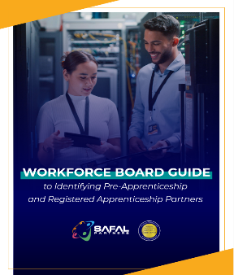
No-Cost Resources
Request no-cost online or in-person training for your organization
Become a Center partner to receive notification of upcoming webinars, Virtual Office Hours
Visit our website for downloadable materials
Guide to Identifying Partners
https://safal.partners/Partner-Resource
© 2024 Safal Partners

Slide 21
Contact Us
Melissa Aguilar-Southard
Alan Dodkowitz
Project Director and Senior SME
Safal Partners
Subject Matter Expert
Safal Partners
© 2024 Safal Partners

Slide 22
Email us your questions at RA_COE@SafalPartners.com
For more information, visit: dolcoe.safalapps.com
© 2024 Safal Partners

Slide 23
Q&A / Discussion
Help is on the Way!: Ways the Workforce System Can Help RA

Slide 24
NJ A-TAC CoP: Next Steps & Reminders
Next Monthly Learning Event: Peer-to-Peer Session - Local Workforce Boards’ Role in RA on Tuesday, March 26th, 11am-12pm ET
Meet and work with your coach (either Brianne or Kassandra) on completing your action plan with RA goals (if not done already)
Look out for recurring monthly emails with CoP reminders/updates and related apprenticeship events and resources (February email sent last week)
As always, contact Shamara at sbownes@jff.org with any questions/requests

Slide 25
Thank You!
Mark Genua, Director, Jobs for the Future, mgenua@jff.org
Shamara P. Bownes, Senior Manager, Jobs for the Future, sbownes@jff.org
XXXXX_MO/YR

