Slide 1
Learning Event #1: Peer-to-Peer Session
The Role of Community Colleges in Registered Apprenticeship: Industry Expansion
Mark Genua, Director, Jobs for the Future | Shamara P. Bownes, Senior Manager, Jobs for the Future
NJ A-TAC Community of Practice | Tuesday, January 30, 2024 | 11:00am – 12:00pm ET

Slide 2
Learning Event 1: Peer-to-Peer Session Agenda
Welcome – Shamara P. Bownes, Senior Manager, Jobs for the Future; Maria Heidkamp, Chief of Innovation & Policy, NJ Council of County Colleges
Agenda Overview – Shamara P. Bownes, Senior Manager, Jobs for the Future
Session Topic Overview/Presenter Introductions – Mark Genua, Director, Jobs for the Future
Community Colleges’ Role in RA: Industry Expansion – County College of Morris; Howard Community College
Discussion – All
Reminders/Conclusion – Shamara P. Bownes, Senior Manager, Jobs for the Future

Slide 3


Learning Event #1: Peer-to-Peer Session Topic
The Role of Community Colleges in Registered Apprenticeship: Industry Expansion

Slide 4
County College of Morris Apprenticeship Programs
Presented By:
Dr. Katrina Bell, Alexandra Hoffmann, and Amber Pantiliano

Slide 5
County College of Morris’ Journey
Addressing a Community Need
  Manufacturers need trained workers
  More family supporting careers needed for non-college bound students
  Results in Advanced Manufacturing and Engineering Center (AMEC)
  Virtual opening during COVID
Starting with an Idea
DOL Scaling Apprenticeship grant opportunity
  Advanced Manufacturing
  8 colleges with CCM as lead
  Zero apprenticeships

Slide 6
Current Apprenticeship Initiatives
Advanced Manufacturing
Pre-Apprenticeship bootcamp
  Interview Week
Current Registered Apprenticeships:
  CNC Operating: Milling
  CNC Operating: Turning
  CNC Operating: Milling and Turning
  CAD/CAM Mechanical Drafter
  Die Manufacturer
  Quality Assurance Inspector
  Robotics Technician
Unregistered Apprenticeships
Healthcare
Current Registered Apprenticeships:
  Pharmacy Technician (held by Bergen CC)

Slide 7


Slide 8
Thank you!
Contact Information
Katrina Bell: Associate Vice President, Workforce Innovation & Experiential Learning
kbell@ccm.edu
Alexandra Hoffmann: Director of Workforce Development
ahoffmann@ccm.edu
Amber Pantiliano: CareerAdvance USA Program Manager
apantiliano@ccm.edu

Slide 9
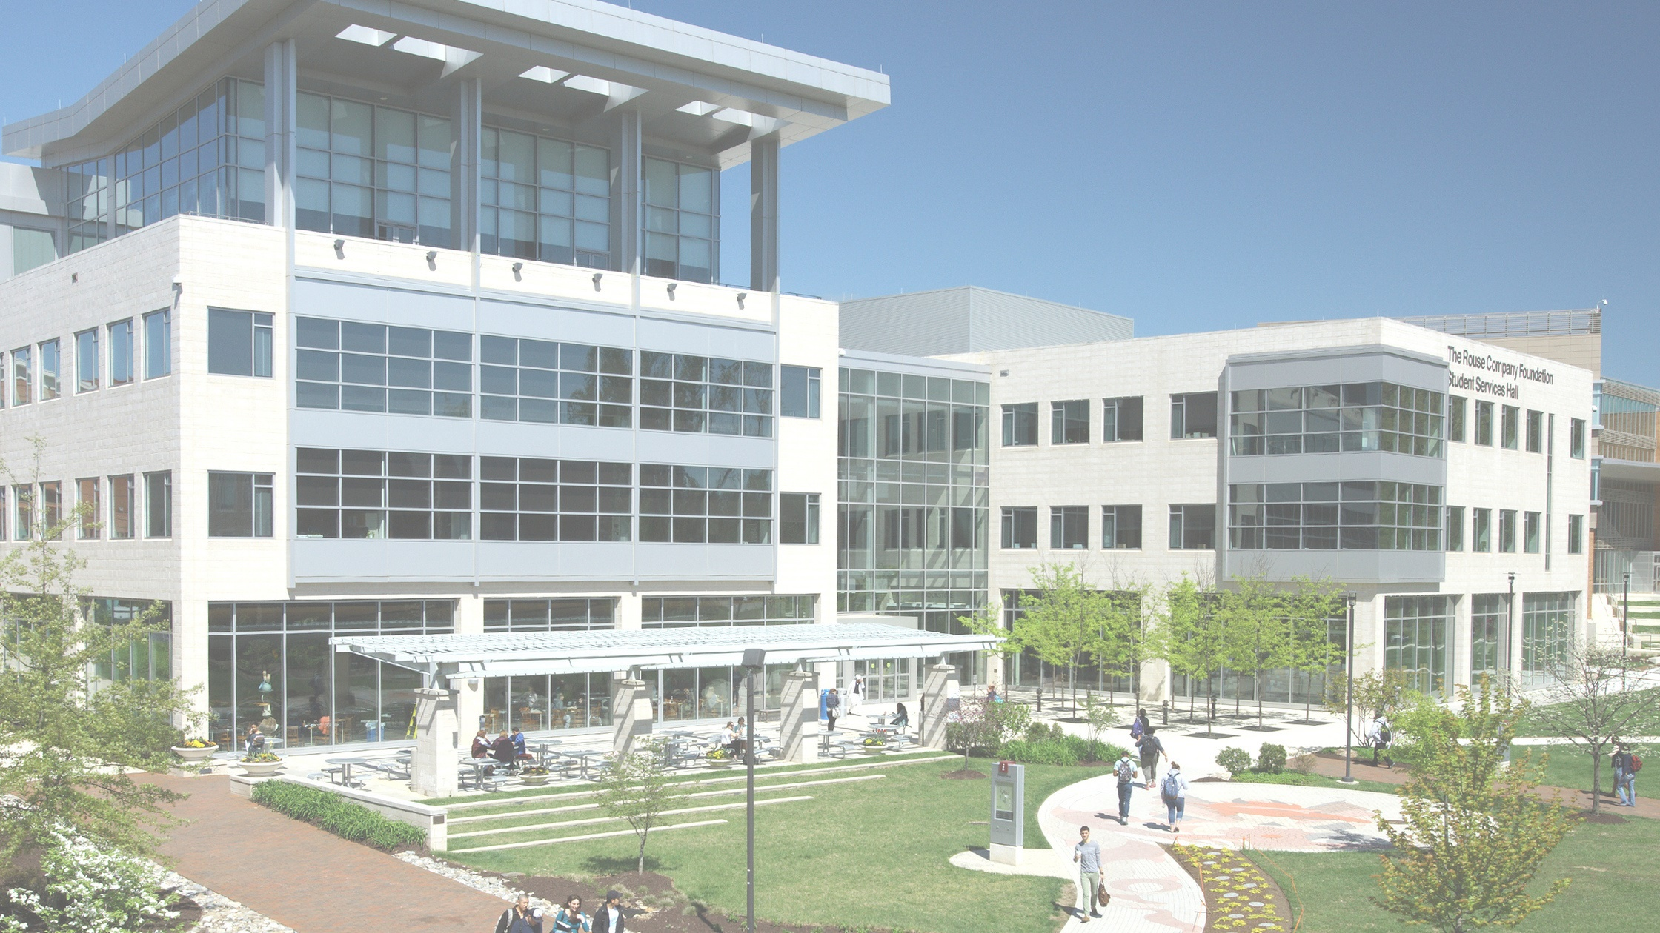

Howard Community College Apprenticeship Programs
IT and Healthcare Occupations
Jackie Anna
Apprenticeship Program Manager

Slide 10
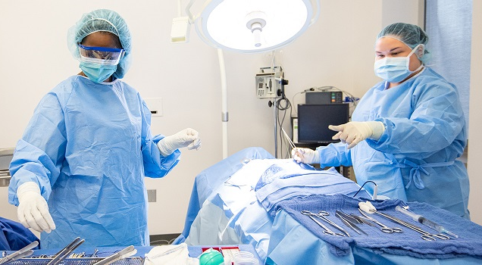
Current HCC Occupations in IT and Healthcare Fields
Healthcare
Surg Tech
LPN
Information Technology:
IT Field Support Specialist
Network Field Support Specialist
Information System Security Specialist
Linux System Administrator
Help Desk

Slide 11
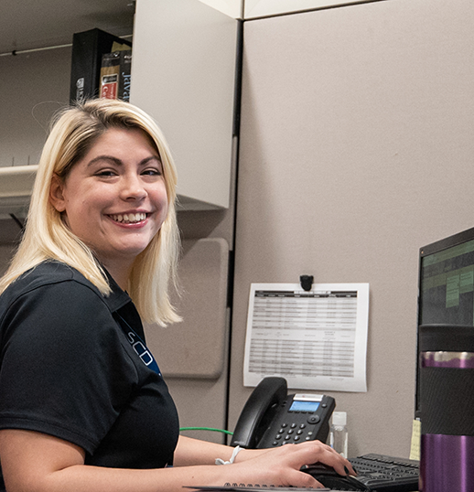
WHY COMPANIES INVEST IN APPRENTICES
  Build up own supply of skilled workers
  Reduce recruiting costs
  Improve productivity and profitability
  Reduce employee turnover and increase employee retention
  Customize training
  Grow talent within the company culture from day one

Slide 12
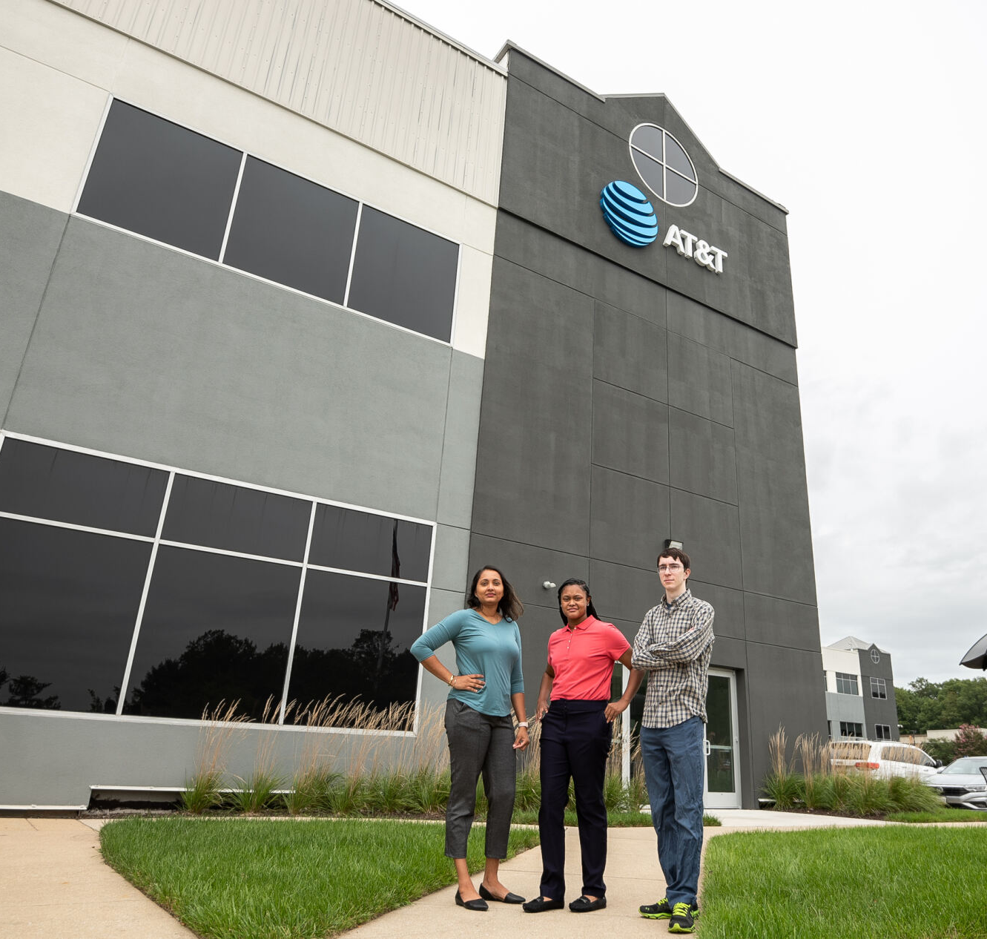
TIPS FOR SUCCESS
Local workforce boards
Grant funding
Employer Partners
Student success stories
Visibility
Advisory Boards
Relationship with local DOL
Related Instruction

Slide 13
Discussion Questions
How can County College of Morris (and others here) enter/gain an apprenticeship foothold into new industries?
How does the ”apprenticeship pitch” to employers change for different industries?
What can be leveraged from apprenticeship success in manufacturing to other industries, like IT and healthcare?
What are some key partners that could assist in entering new industries with apprenticeship?
What other industries (not mentioned so far) are Focus Sites interested in entering with apprenticeship? And how can that be accomplished?

Slide 14
NJ A-TAC CoP: Reminders
Next Monthly Learning Event – Webinar: Role of Local Workforce Development Boards in RA on Tuesday, February 27th, 11am-12pm ET (recurring the 4th Tuesday of every month)
Follow-up with your assigned coach (either Brianne or Kassandra) and schedule your initial call/meeting (if not done already)
As always, contact Shamara at sbownes@jff.org with any questions/requests
Recordings available at www.njccc.org/a-tac

Slide 15
Thank You!
Mark Genua, Director, Jobs for the Future, mgenua@jff.org
Shamara P. Bownes, Senior Manager, Jobs for the Future, sbownes@jff.org
XXXXX_MO/YR

