Slide 1
Monthly Learning Event
Effective Employer Engagement Strategies in Registered Apprenticeship
Mark Genua, Director, Jobs for the Future | Shamara P. Bownes, Senior Manager, Jobs for the Future
NJ A-TAC Community of Practice | Tuesday, May 28, 2024 | 11:00am – 12:00pm ET

Slide 2
Monthly Learning Event: May Agenda
Welcome – Shamara P. Bownes, Senior Manager, Jobs for the Future
Agenda Overview – Shamara P. Bownes, Senior Manager, Jobs for the Future
Session Topic Overview/Presenter Introductions – Mark Genua, Director, Jobs for the Future
Effective Employer Engagement Strategies in Registered Apprenticeship – Aimee Densmore, Director, Office of Apprenticeships, Parkland College & Sam Hinkle, Apprenticeship Success Coordinator, West Michigan Works!
Q&A/Discussion – All
Reminders/Conclusion – Shamara P. Bownes, Senior Manager, Jobs for the Future

Slide 3
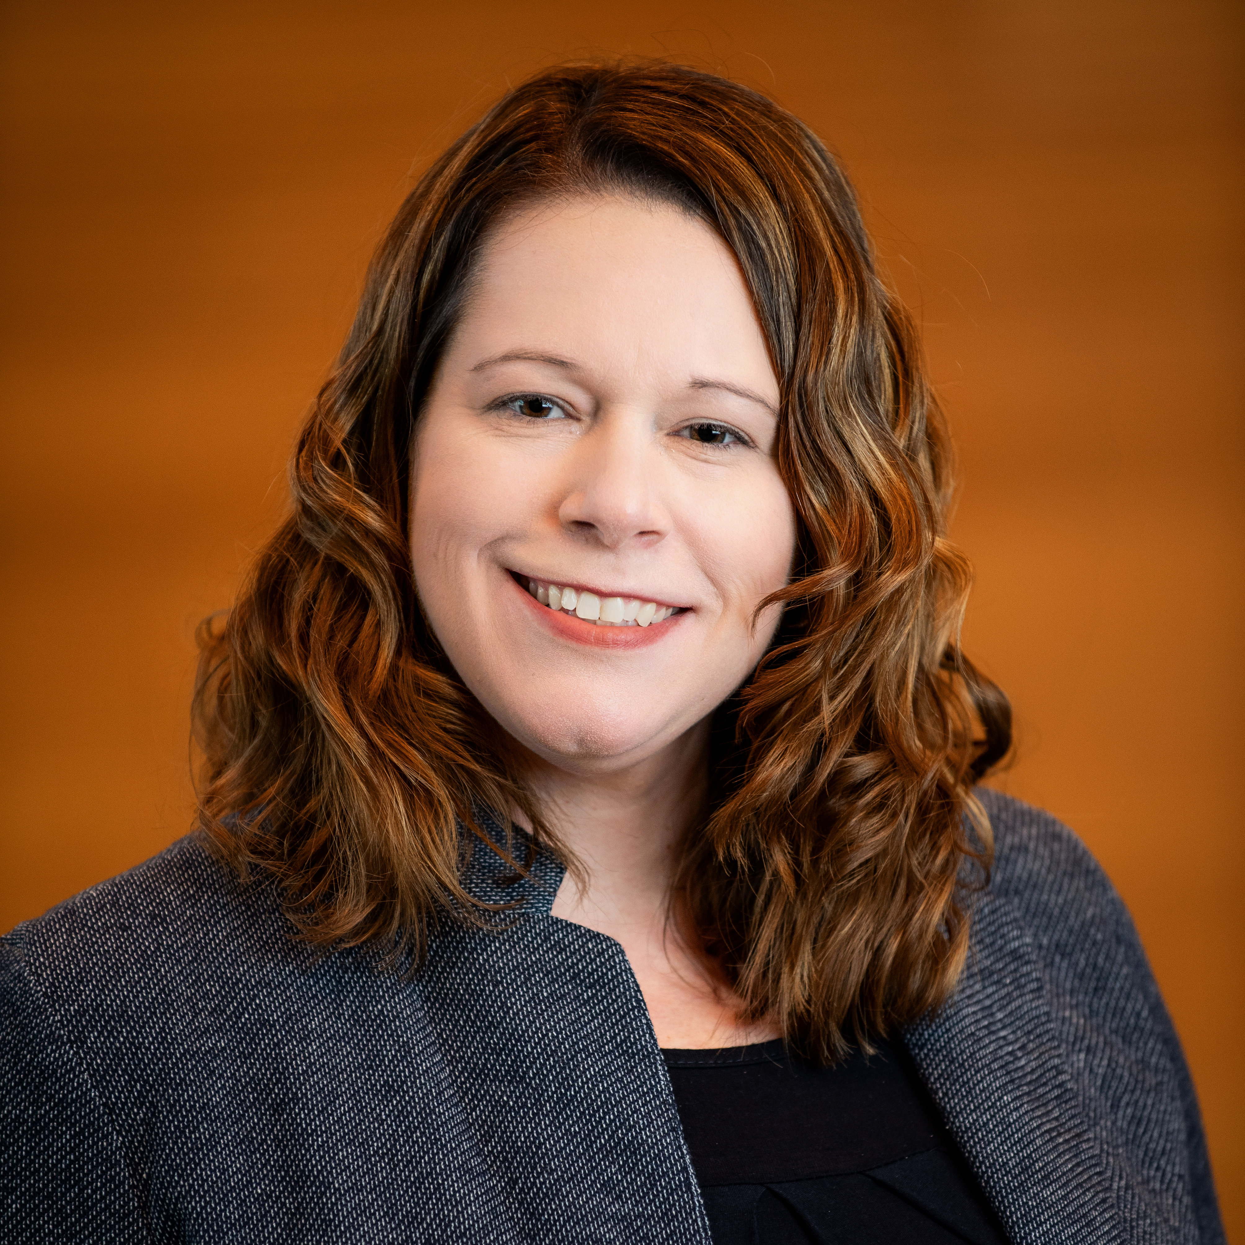

Meet the Presenters
Learning Event #4: Webinar Topic
Employer Engagement topic
Monthly Learning Event: Effective Employer Engagement Strategies in Registered Apprenticeship
Aimee Densmore
Parkland College
Director
Office of Apprenticeships
Samantha Hinkle
West Michigan Works
Apprenticeship Success Coordinator

Slide 4
Employer Engagement Strategies

Slide 5
Where to start?
Schedule a 30-min needs assessment
Add an hour for a facilities tour if applicable
Mention that CCs exist to serve area employers
FREE needs assessment, expertise, resources
Include an HR rep and direct supervisor

Slide 6
Set your mentality
Not selling anything
How can we partner to serve you?
Take off your community college hat
Walk in without a sales goal

Slide 7
Build trust
Be honest and authentic
Actively listen and ask questions
Skip what you know already
Don’t hold back
Do what you say you will

Slide 8
Look for the culture
Pro-employee
Open to new-fangled ideas
Willing to put money behind their/your ideas
Can let go of old concepts
Doesn’t blame “kids these days”

Slide 9
During the meeting
Talk about the flexibility available
Provide needed training in shortest time for lowest cost
Share a couple of examples or stats
Provide financial assistance options
Schedule a 15-min follow up call within two weeks

Slide 10
After the meeting
Send any follow up info promised asap
Make sure follow up meeting is scheduled
Connect employer to your partners
Follow up with those partners for insider info
Add employer to contact list for future events

Slide 11
Connect with me
Aimee Densmore
Director, Office of Apprenticeships
Ph 217/373-3838
adensmore@parkland.edu

Slide 12

Apprenticeship Overview: Role as an Intermediary

Slide 13
West Michigan Works! & Apprenticeships
West Michigan Works!
Potential Funding Sources
Related Training & Instruction
Community Partners
Local Education
(K-12)
USDOL
Office of Apprenticeship
Industry Councils
Notes:
These different areas are engaged by the apprenticeship team on a regular basis.
Industry councils: Industry councils bring employers together and, along with community partners, address talent shortages and build a pipeline of talent for the future.
Potential funding sources: Funding is a key part of starting and maintaining any apprenticeship program. Many businesses (small, med, or large) cannot maintain programs without access to some funding. USDOL registered apprenticeship is an area that can help offset costs and allow other funds to be allocated essentially allowing their bottom line to remain the same or even increase.
RTI: Partner with many different RTI providers across the US. Main partners that WMW works with are the community colleges. The partnership allows for communication at the same level for the CC, WMW, and the employer. Other providers that we have worked with include Roubxe which is an online based learning for the culinary arts. National Fire Place Institute, Chimney Safety Intitute of America, West Michigan Construction Institute
Community Partners: Community Partners are another advocate for apprenticeships. Not only do they refer employers to WMW, but they are another pipeline of talent that employers can tap into. Many employers are looking to employ more job seekers or find a pool of candidates that maybe don’t feel like they should apply or to gain more diversity in their workforce. Examples of partners: the Hispanic Center of West Michigan, Urban League of West Michigan, Michigan Rehabilitation Services, among many others
Local Education (K-12): Educating the next generation is vital to the sustainability of any community. We work with local school districts as well as career tech centers to speak about other opportunities available to students after high school. We also speak to the benefits such as receiving a paycheck right away, little to no student debt, starting a career in something that they like or are passionate about, stackable credentials that are recognized nationally.
USDOL: The USDOL is the main partner for the WMW apprenticeship team. If there are questions, concerns, new programs, changes to existing programs etc, we contact the DOL to ensure that we are doing right by the employer and the apprentices.
It is important to note that WMW apprenticeships does not work for the DOL or the US government or even the state office of labor and economic development. We are a quasi governmental organization that reports to a workforce board. We work closely with the state and national government, but we operate for in the west Michigan region.

Slide 14
West Michigan Works! as the Intermediary
Liaison with the Department of Labor
Simplified start up of registered apprenticeship programs
Flexible programming that an employer can control (customizable)
Partnerships with local community colleges and training providers
Partnership with K-12 districts to expand recruitment pool
Potential for access to funding
Notes:
Liaison with the Department of Labor- As the liaison, we work with employers to register programs that are under the current standards. We also look to add new programs that are already approved under the DOL. But not with WMW. This has become more frequent in the construction industry given the prevailing wage legislation (House Bill no. 4007, part of Act no. 10) for the state of MI. Adv MFG has the greatest number of occupations, employers, and apprentices, however, the apprenticeship model is being adapted by the other industries.
Simplified start up of registered apprenticeship programs- The idea is to make it as streamlined as possible for the employer. Limit the times that paperwork needs to go back and forth. Use technology to help speed up the process. Establish effective forms of communication between WMW and the employer.
Partnerships with local community colleges and training providers With having that strong relationship, WMW is able to feel out what would work best for an employer or look at having more than one training provider in a program.
Partnership with K-12 districts to expand recruitment pool
Potential for access to funding- making the employers aware of grant funding opportunities as well as what is required of an apprentice and employer. Also it is about being transparent with employers that grant funding may not always be available so reviewing plan B or knowing other options for apprentices through the training provider. “it’s all in who you know”

Slide 15
What does a conversation look like with an employer?
What is it that your business/company do?
How did you hear about apprenticeships?
What is the main motivation for starting an apprenticeship?
Do you have any knowledge of apprenticeships coming into the meeting?
What is your timeline in getting an apprenticeship up and running?
How many apprentices are you looking to have registered?
Notes:
In the fact finding meeting, these are the questions that I start with. This allows me to gauge the company’s commitment to apprenticeships. If they were referred because they heard there was grant funding, then I want to make sure they hear all the benefits of an apprenticeship and note that grant funding may not always be available. If the apprenticeships are only taking place to receive grant dollars it may not be an sustainable model for their employees. By asking these questions, I can also start to think of occupations that would work best or at least get the employer looking at so if they do want to pursue an occupation we have a starting point.
I also explain what my role is in the apprenticeship processes and what I can do to help assist them from beginning to end.
From here I also go through what the process looks like and timelines.

Slide 16
RAP Development Process
Fact Finding Meeting
Review occupation documents
Complete Employer agreement (Appendix D)
Register employer in RAPIDS
Register apprentice(s) in RAPIDS
Check ins with all parties during program (about every 6 months)
Complete apprentices with required documentation
Notes:
Fact Finding meeting: What does the employer do? What are they looking for as far as apprenticeships? What is the time line to get it started? Explaining apprenticeships and what is required. What it is an intermediary does and how all the pieces fit together.
Review occupation documents- appendix As or occupations that are approved
Appendix D- Identification of Occupation, employer contact info, minimum qualifications of an apprentice, wage schedule, and RTI provider(s) and course listings
Register apprentices- Send spreadsheet to the employer to complete then send document to apprentice to complete then register them in the RAPIDS
Check ins- review hours and classes to ensure apprentice is on track, address any issues that have come up in the apprenticeship. Obtain documentation in accordance with the DOL requirements for document retention.
Complete in RAPIDS with final hours log and unofficial transcript. As well as ending wage and completion date.

Slide 17
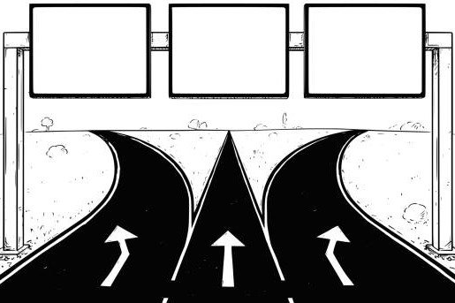
West Michigan Works! & Apprenticeships
New RA program
(US-DOL approved
and NOT
with WMW)
Existing RA program
(US-DOL approved
and with WMW)
New RA Occupation
(Not approved by
US-DOL or WMW)
Approx. 2 weeks
for start up
Approx. 8 weeks
for start up
Approx. 2 years
for start up

Slide 18
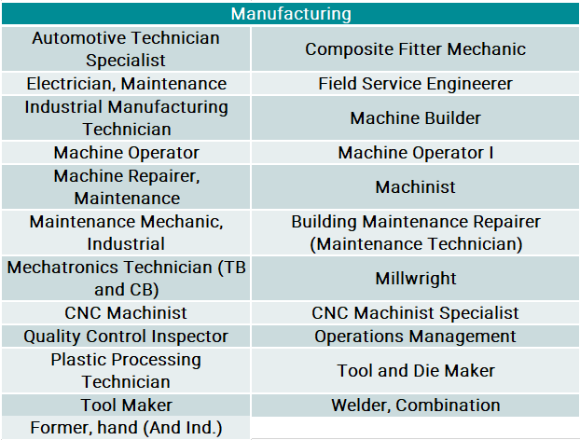
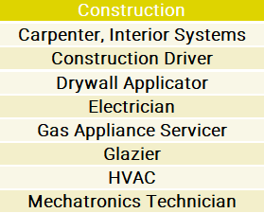
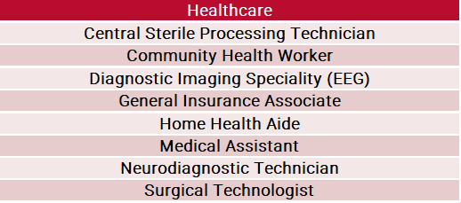


West Michigan Works! Registered Apprenticeship Programs

Slide 19
Registered Apprenticeship Programs
US Department Of Labor Registered apprenticeships
 | Advanced Manufacturing |  | Construction |  | Healthcare |  | IT |  | Professional Services
Active Apprentices | 86 |  | 57 |  | 41 |  | 0 |  | 16
Completed Apprentices | 95 |  | 27 |  | 189 |  | 4 |  | 0
Employers | 53 |  | 9 |  | 20 |  | 1 |  | 1
West Michigan Works! currently holds the sponsorship for 47 US Department of Labor registered apprenticeships, with 200 active apprentices and 84 participating employers.

Slide 20
Successes and Challenges as an Intermediary
Successes
Whole new world
Growing occupation and
employer numbers
Recognition from community
Partners
Technology
Challenges
Learn as you go
Putting a value on capacity
Research and pivot
Technology
Notes:
Successes
Whole new world- got into apprenticeships by happenstance. There is a huge learning curve, but don’t be afraid to ask questions but be aware there are gray areas that need to be navigated.
Growing occupation and employer numbers- this number continues to grow which means that more employers are providing apprenticeships without having the “burden” of doing it all themselves. WMW is a tool/resource for the community and growing numbers means that we need to be there to support for the greater good!
Recognition- receiving referrals from community partners is a praise I hold very close to my heart. They have trust in my ability and WMW’s processes rather than going right to the DOL and the DOL refers employers as well.
Technology- allows for me to reach more people and have a faster processing time when it comes to paperwork. WMW uses Conga sign to complete employer agreements, apprenticeship registration, grant registration packets, and more. We also use Microsoft teams to facilitate meetings and I specifically use Calendly to help in scheduling meetings. This cuts down on the back and forth emails about dates and times that works. The employer can view my schedule and find a time that works best for both of us.
Challenges
Learn as you go- there have been many times that I could only read so much before just doing the work. There is much grace when getting a program up and going, but it can take some trail and error in to order to find your way.
Putting a value on capacity- It is very hard to put a value on how much you can do but it something that even I am slowly learning. I have not turned an employer away, however, I do have to be realistic with timelines that I set based on my workload.
Research and pivot- there are times that you work very hard on getting an occupation and/or program just right just to either scrape the whole thing or make other changes. This can be frustrating, but having confidence in your ability can help push through to plan B which I have learned to have at all times.
Technology- Many times information can get lost or misplaced in anyone’s inbox. This requires more follow ups depending on the information being requested. But it is manageable!

Slide 21

Contact Information
Samantha Hinkle
Apprenticeship Success Coordinator
West Michigan Works!
shinkle@westmiworks.org
m (616) 295-7395

Slide 22
Discussion Questions
How do you approach engaging employers in Registered Apprenticeship? Any best practices to share?
What are push backs that you receive from employers when they are considering apprenticeships?
How can they be addressed?
How does your “employer pitch” change based on the industry/occupation?
Are there other entities/initiatives that you can leverage in your employer engagement efforts?
What kinds of information can help to identify employers that might benefit from apprenticeships?
What factors do you consider?
How do you prepare for the first employer meeting? How do you handle follow-up?
How do you communicate the benefits of Registered Apprenticeship to employers?
What problems can apprenticeship solve for?
How can you determine if your program is effectively engaging employers?
Other questions?

Slide 23
NJ A-TAC CoP: Next Steps & Reminders
Next Monthly Learning Event: Tuesday, June 25th, 11am-12pm ET
Continue coaching calls with Brianne/Kassandra for customized support
Document progress in meeting action plan goals
Mid-point pulse check survey to be sent out
As always, contact Shamara at sbownes@jff.org with any questions/requests

Slide 24
Thank You!
Mark Genua, Director, Jobs for the Future, mgenua@jff.org
Shamara P. Bownes, Senior Manager, Jobs for the Future, sbownes@jff.org
XXXXX_MO/YR

