Slide 1

Bridging High School and College Through Scalable Financial Literacy Partnerships
NJCCC Opportunity Summit 2026

Slide 2
Presenters
Dr. Anthony J. (A.J.) Trump
Vice President of Student Affairs
Dr. Andrew Tomko
Vice President of Academic Affairs and Provost

Slide 3
New Jersey financial literacy graduation requirements
Uneven student access to quality financial literacy instruction
Need for scalable college readiness models
Demand for stronger K–12 and community college alignment
Increasing focus on economic mobility and student onboarding
Why This Program Matters

Slide 4

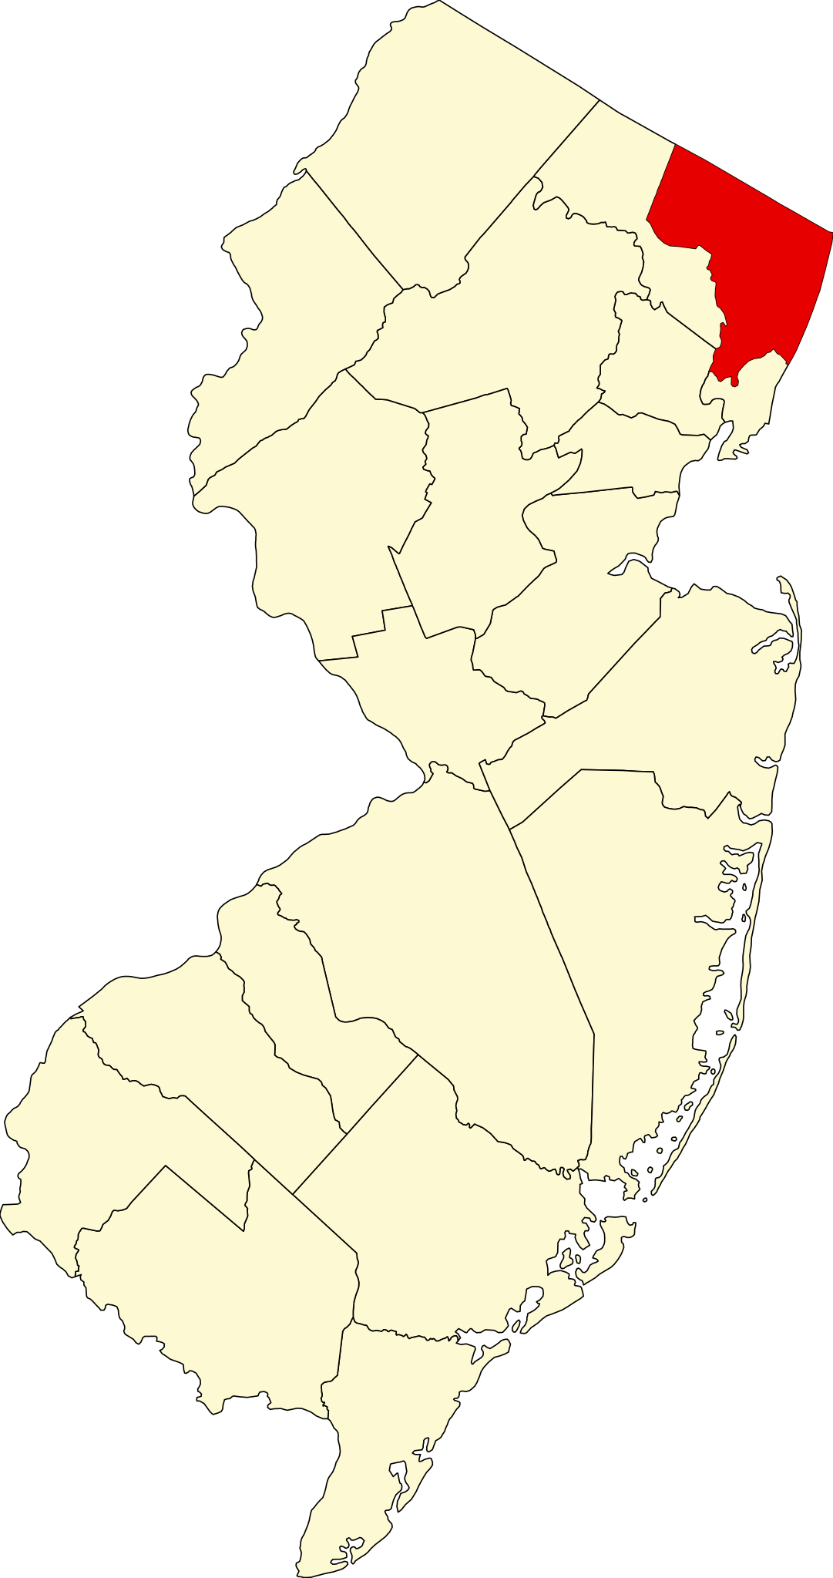

Innovative Collaboration
River Dell High School
Oradell, NJ
and
Bergen Community College
Paramus, NJ

Slide 5
Addressing the Issue
River Dell High School
  Meets Graduation Requirement
  Supports Student Elective Overhaul
  Decreases Scheduling Conflicts
  Provides a Postsecondary Experience
  Builds Financial Confidence and Skills
  Provides a Better Experience than Before
Bergen Community College
  Strengthens High School Partnerships
  Provides Additional Pathways for Recruitment of Students
  Exposes Students to College Coursework
  Creates Trust and Pathways for Future K-12 Partnerships

Slide 6

Course Design: Access and Scale
Canvas Course: Fully online and asynchronous
Affordable: Low-cost tuition structure
Flexible: Flexible scheduling for high schools and students
Rigorous with Guard Rails: Exposure to real college systems and expectations with support from both partners
Replicable: Easily scalable to other districts
Accessible: Minimal barriers for students and families

Slide 7
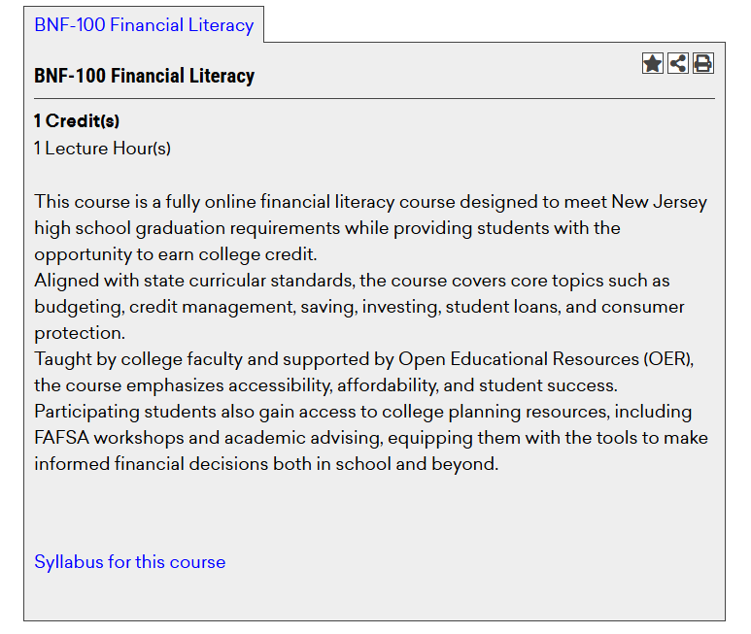


Course Overview and Value
BNF-100: Financial Literacy
$50
0 or 1
Tuition Cost
College Credit

Slide 8
Course Structure
Thematic modules (budgeting, saving, credit, investing, etc.)
Power Points, Videos & Discussion Boards
Progress tracking & built-in feedback

Slide 9

Student Engagement Strategies
Real-world financial scenarios
Interactive tools and simulations
Encouragement of self-directed learning
Weekly progress updates sent to school district
Weekly help sessions and tutoring

Slide 10
The Pilot
Shared Responsibilities:
Bergen: curriculum, faculty, advising, onboarding, Canvas, support services
River Dell High School: student identification, communication, progress monitoring, reinforcement
Outcome:
A seamless, scalable, replicable, dual-enrollment-style experience for non-matriculated students.
Summer 2025:
119 River Dell Students SUCCESSFULLY Completed the Non-Credit Pilot Course

Slide 11

The Application Process:
Keep it Simple!

Slide 12
Scaling the Model
1. Develop partnership agreements
2. Align curriculum and delivery model
3. Coordinate enrollment logistics
4. Establish shared communication protocols
5. Deliver student onboarding and support
6. Monitor progress collaboratively
7. Evaluate and refine the model

Slide 13
Early Evidence of Impact
Semesters Active | Partner High Schools | Successful Completions
3 | 6 | 715
Summer 2025 | Fall 2025 | Spring 2026
*Pilot* River Dell | River Dell, Cresskill, Fort Lee | River Dell, Cresskill, Fort Lee, Midland Park, Dwight Morrow, Applied Technology
119 students | 416 students | 180 students
Two New Partners Joining Summer 2026:
New Milford
Garfield

Slide 14
Key Lessons Learned
Clear role definition is essential
Shared communication improves persistence
Simplified onboarding reduces friction
Student support must be proactive and coordinated
Cross-sector trust drives sustainability
Scalability requires operational simplicity
Affordability is essential
Faculty engagement is critical (HS and College)
Flexibility with district needs is crucial

Slide 15
Thank You
Questions & Discussion
Dr. Anthony J. Trump
atrump@bergen.edu
Vice President of Student Affairs
Bergen Community College
Dr. Andrew Tomko
atomko@bergen.edu
Vice President of Academic Affairs & Provost
Bergen Community College

