Slide 1

Expanding Opportunities Through Dual Enrollment: A Panel Discussion
Christopher Conzen, Ed.D. Acting Vice President for Student Affairs and Enrollment
Hudson County Community College
Tanya Da Silva Director of Early College and Dual Enrollment Passaic County County Community College
Cara Novak Director of Educational Partnerships
Brookdale Community College
Shay Wadher Director of K-12 Partnerships
Raritan Valley Community College

Slide 2

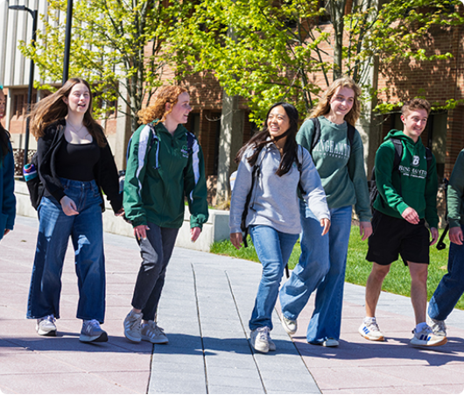
Intentional Pathways to Success
Dual enrollment has moved beyond "random acts" to become a critical component of New Jersey's opportunity agenda.
By creating intentional pathways, NJ community colleges empower high school students to earn college credits and achieve degree-based milestones long before high school graduation.
This panel explores three distinct institutional approaches to high-impact partnership.

Slide 3
Three Strategic Focus Areas
1. CTE Alignment & Pathways
Streamlining career readiness through concurrent enrollment, articulation mapping, and direct credits.
2. General Education Clusters
Structuring foundational "Core 30" credit blocks with hybrid delivery models for high transferability.
3. Full-Degree Pathways
Integrating intensive advising and structured coursework to enable an Associate degree at high school graduation.

Slide 4
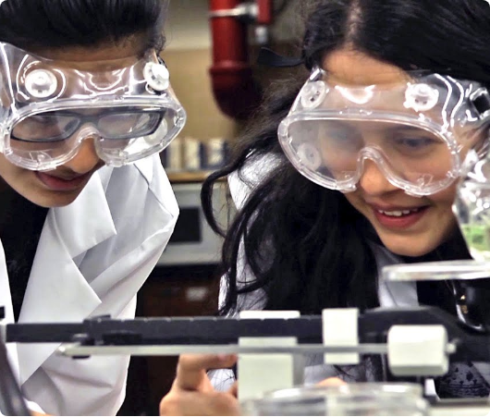
Focus 1: CTE Alignment & Pathways
Streamlining Career Readiness
Clear CTE pathways to college and careers
Advanced standing for approved coursework
Less duplication, faster completion
Alignment with RVCC’s strategic plan & NJCCC’s action pillars

Slide 5






Focus 2: General Education Clusters
Achieve 30 - PCCC
Core 30
Hybrid Delivery
Students enroll full-time in both the fall and spring semesters.
Work with counselors to ensure students receive high school graduation requirements.
Celebrate students!
Earning 30+ credits in highly transferable foundational courses.
Combining concurrent high school enrollment with college-taught modalities.

Slide 6

Focus 3: Full-Degree Pathways
The Associate Degree Goal
Strategic integration allows students to graduate high school with an Associate degree in hand.
Brookdale Community College Early College High School Program
488 Early College High School graduates (2020–2026)
Students begin taking college courses during their freshman and sophomore years at their high school.
Students attend Brookdale full-time during their junior and senior years, either on campus or online.
Students earn an associate degree from Brookdale Community College before graduating from high school.
Students work with high school counselors and Brookdale Educational Partnerships staff to ensure they are meeting both high school graduation requirements and associate degree requirements.

Slide 7
The Future of NJ Dual Enrollment
"Dual enrollment is no longer a program of privilege; it is an essential on-ramp to New Jersey's workforce and degree attainment goals."
— The Opportunity Agenda Perspective

Slide 8
Questions?
Expanding Opportunities Through Dual Enrollment

Slide 9




Image Sources
https://www.binghamton.edu/news/images/uploads/features/1-Students-Pik1.jpg
Source: www.binghamton.edu
https://img.youtube.com/vi/QjpdWxD2IAw/maxresdefault.jpg
Source: www.edutopia.org
https://www.graduationsource.com/media/catalog/product/cache/3d45c019409e4e20f2cffb6f8fd4d334/a/s/associates_hood_1.jpg
Source: www.graduationsource.com
https://files.su.ac.za/public/su-international/images/2026-03/panel-discussion-sian-day-3png.png
Source: www.su.ac.za

