Slide 1
Improving Holistic Supports: A Strategy for Student Success
Leanne Davis & Da’Shon Carr
June 10th, 2026

Slide 2

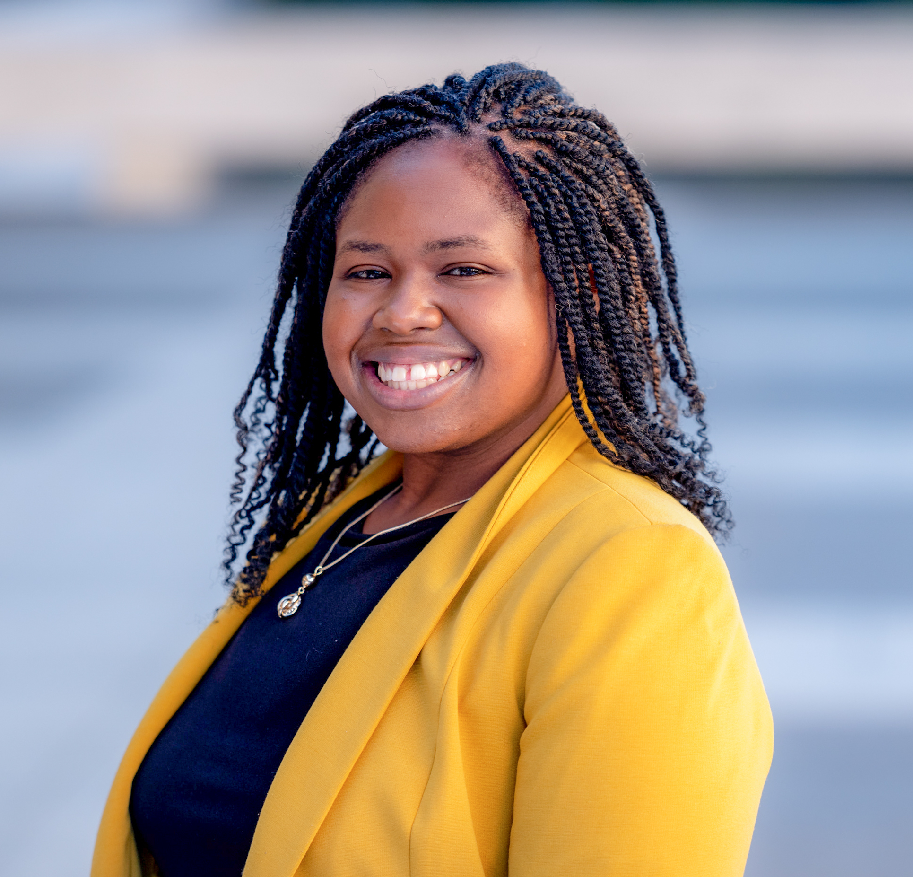
Education Northwest
Leanne Davis
Managing Researcher
Da’Shon Carr
Researcher
We support colleges and practitioners in advancing student success through evaluation, technical assistance, and evidence-based practices.

Slide 3
Building Community to Expand Opportunity for New Jersey College Students

Slide 4


Advancing student success through sustainable and comprehensive support systems

Slide 5
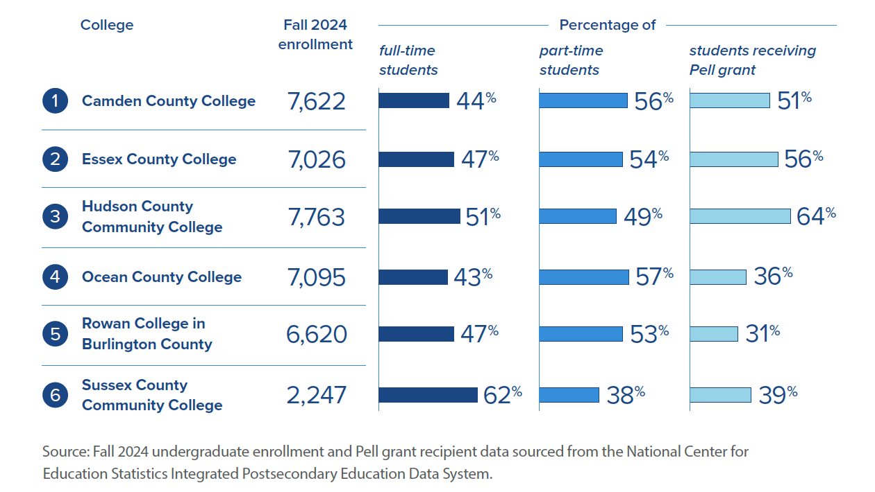
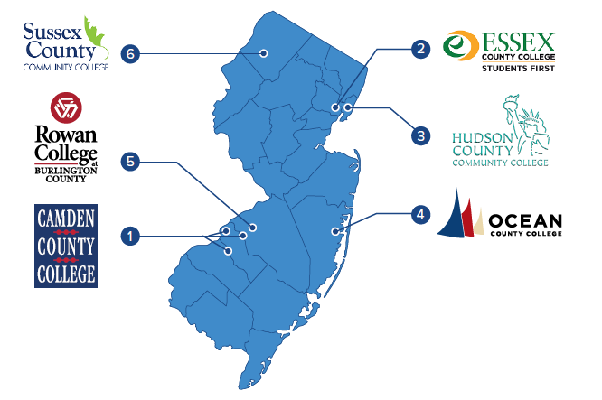
Six distinct colleges, one shared mission

Slide 6
When colleges learn together, students benefit
Created structured opportunities for the six colleges to share strategies, troubleshoot together, and build on each other’s ideas.
Produced outcomes that you wouldn’t get from a competitive grant model.
Designed as a collaborative learning network, not a competitive grant.
Notes:
The work was guided and structured through a community of practice model.
Accelerated adoption – practices shifted across NJ’s remaining 12 community colleges as participants shared strategies formally at convenings or informally through conversations.
Surfaced place-based variation – each college has a distinct and unique college population shaped by county demographics and community resources, allowing colleges to adapt rather than replicate.
Developed system-level leadership – empowered college staff and practitioners to lead and champion this work within the NJCCC and throughout the state.

Slide 7
Cross-Cutting Lessons

Slide 8
Across all colleges, we learned:
This work requires dedicated staff, not add-on roles
01
Student voice and peer models are must-haves, not optional
02
Community partnerships are strong in connecting students to services.
03

Slide 9


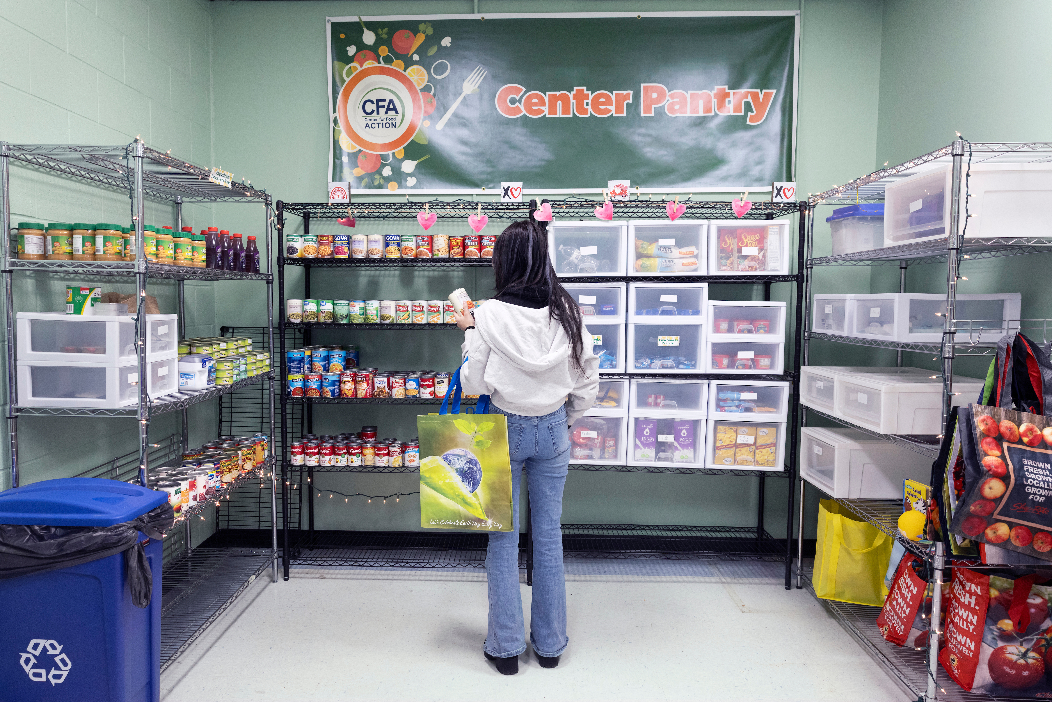
Case studies: Examining college approaches in depth
Reducing Stigma to Increase Access to and Use of On-Campus Wraparound Supports
Ocean County College and Sussex County Community College
Transforming Your Campus to Provide Mental Health and Trauma-Informed Care
Camden County College & Hudson County College
Increasing Awareness of Existing Social Service Programs
Essex County College & Rowan College at Burlington County
Photos by Allison Shelley/Complete College Photo Library
Notes:
Camden County College and Hudson County Community College demonstrated how elevating student voice uncovers real barriers to access and drives meaningful change. Through partnerships with students, clubs, and organizations—and collaboration with community and government partners—these institutions expanded access and strengthened trauma-informed, student-centered care systems.
Ocean County College and Sussex County Community College showed how intentional outreach strategies can reduce stigma and increase engagement with campus supports. By leveraging technology, engaging faculty and staff, and implementing basic needs navigators, these colleges created innovative pathways that normalize help-seeking and connect students to timely, tailored support.
Essex County College and Rowan College at Burlington County demonstrated how proactive outreach and cross-sector partnerships can increase students' awareness of and use of public benefits. By leveraging data to identify student needs, building trusted partnerships with community and county agencies, and hosting on-campus SNAP outreach and enrollment events, these colleges created accessible pathways that help students understand eligibility requirements, complete applications, and access critical social services.

Slide 10
Sustaining This Work to Ensure Students Achieve Postsecondary Success

Slide 11
Driving progress to New Jersey’s postsecondary attainment goal
Elevate holistic student support in the 2040 Attainment Goal Framework.
Make the Hunger-Free Campus grant permanent and grow the funding pool.
Create a dedicated state funding stream for basic needs coordination positions.
Invest in a shared data infrastructure across New Jersey community colleges.

Slide 12



Thank you
Leanne Davis & Da’Shon Carr
educationnorthwest.org

