Slide 1
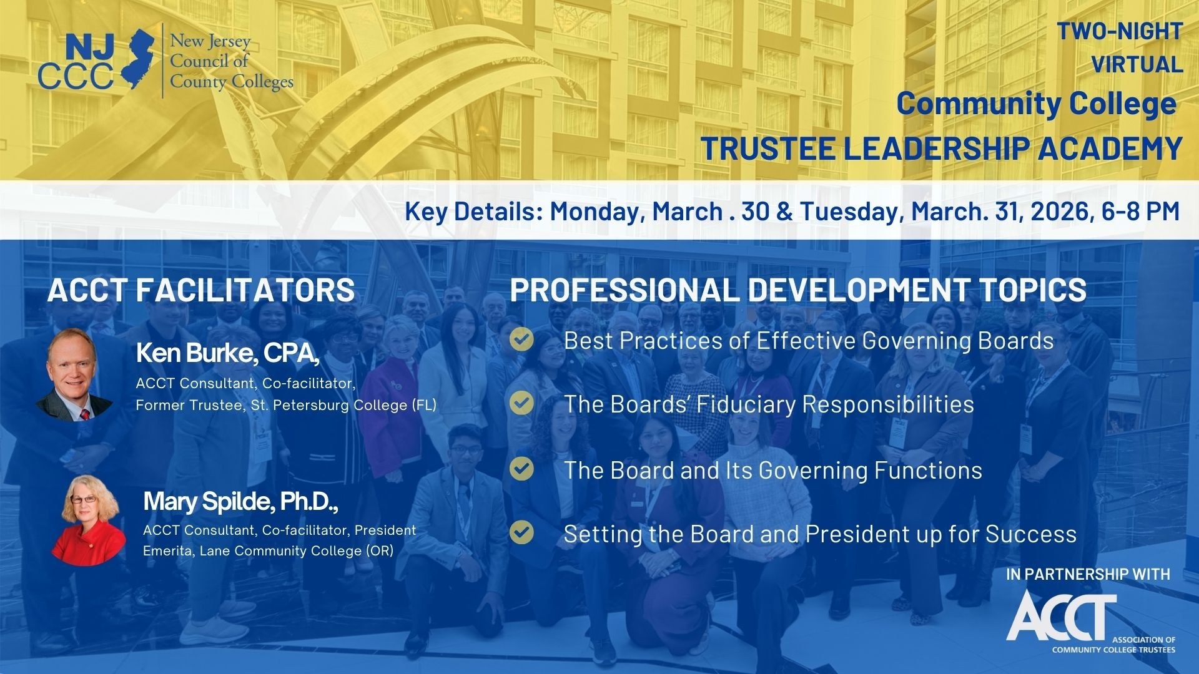

Slide 2


      New Jersey Community College Virtual Trustee Leadership Academy
Welcome Remarks – Ice Breakers
Aaron Fichtner, President, New Jersey Council of County Colleges
Ken Burke, Facilitator, ACCT Consultant; Former Trustee, St. Petersburg College, Florida
2

Slide 3
      New Jersey Community College Virtual
      Trustee Leadership Academy
COUNCIL MISSION
  Provides leadership for collaboration and innovation of community colleges to advance economic and educational opportunity and economic impact.
STRUCTURE OF THE COUNCIL
  Nonprofit organization enshrined in state law: 18A:64A-26-29.
  Governed by the Presidents and Trustee Chairs of all Community Colleges in the state.
  Committees of Presidents and Trustees perform key functions.
  Funded by assessment of dues from the community colleges (determined annually by the Council), and by state, federal, and philanthropic grant funds to support specific priority initiatives.
KEY FUNCTIONS
Vision
State Policy
Collaboration
Initiatives
Statewide Partnerships
For more information: www.njcommunitycolleges.org
3

Slide 4
VISION
Develops a shared vision for community colleges based on extensive collaboration and involvement of all 18 community colleges
The Council released the Opportunity Agenda in Spring 2024, updated in Fall 2025 that is guiding all efforts of the Council.
The Agenda is built around 4 Pillars:
Pillar 1: Helping All High School Students Access Pathways to Postsecondary and Career Success
Pillar 2: Fostering Student Success and Completion in Postsecondary Education and Training
Pillar 3: Building Transparent, Seamless, and Stackable Pathways That Respond to the Changing Economy
Pillar 4: Helping Adults Attain the Credentials They Need for Career Mobility and Labor Market Success
4

Slide 5
Updated Opportunity Agenda: Pillars and Foundational Elements
5

Slide 6
STATE POLICY
Serves as the primary coordinating entity for community colleges, providing guidance and leadership to the Governor, state agencies, and the State Legislature, on all issues concerning community colleges.
  Consulted on the development and design of legislation, regulations, and state-funded grant programs pertaining to community colleges including pilots and programs
  Develops an annual unified state budget recommendation to the Governor and the State Legislature for needed investments in community colleges to meet strategic priorities.
6

Slide 7
      New Jersey Community College Virtual
      Trustee Leadership Academy
Collaboration
Serves as an entity to join together community colleges to support collaboration and improve efficiency:
Operates the Community College Consortium for Workforce and Economic Development to advance partnerships with businesses, labor unions.
Operates the Community College Joint Purchasing Consortium to seek economies in the purchase of goods and services with a goal of increasing efficiency, reducing redundancy, sharing services, and promoting regional collaboration and contracting where appropriate.
Convenes community college leaders (affinity groups) to share promising practices and identify opportunities for collaboration.
Undertakes and promotes professional development for faculty and staff.
Collaborates on marketing and promotion of community colleges.
Serves to enhance the availability of data to inform community college decisions.
7

Slide 8
COLLABORATION (continued)
FUNDING FORMULAS
Responsible for developing and maintaining formulas for the allocation of state investment in community colleges to ensure that all community colleges receive operational support in an equitable and transparent manner, including:
  State operational aid to community colleges: current performance-based funding formula is focused on access, equity, and success metrics
  Chapter 12 capital funds.
  Perkins program (administered by the NJ Department of Education) for occupational-focused programs.
ACADEMIC COLLABORATION
Ensures stronger collaboration on academic issues, including but not limited to:
Maintains a statewide general education framework for community colleges to ensure seamless transfer of credits and approve general education courses delivered by community colleges;
Approves credit courses for use in the distribution of state operating aid to community colleges;
Developing a unified directory of programs;
Develops policies and initiatives to expand academic and workforce-related dual enrollment, credit for prior learning opportunities, and improved transfer experience.
8

Slide 9


      New Jersey Community College Virtual
      Trustee Leadership Academy
CURRENT STATEWIDE partnerships
NJ Pathways to Career Opportunities: Aligning Education to Build an Innovative Workforce,
a partnership with the New Jersey Business and Industry Association and funded in the state budget
brings together employers, industry associations, labor unions, education institutions, and workforce
development partners to provide students and workers with the education and career pathways
they need to find new careers and opportunities to achieve a competitive wage, and to ensure
that employers have access to a highly skilled workforce to meet critical labor market needs.
Click here to learn about NJ Pathways to Opportunities
Community to Opportunity: Building Community to Expand Opportunity,
funded by the Tepper Foundation, assists Community Colleges to develop and implement a
comprehensive strategy for addressing the basic needs of students, like nonacademic barriers
such as hunger, childcare, mental health and
wellness, transportation, and housing.
Click here to learn about Community to Opportunity
9

Slide 10
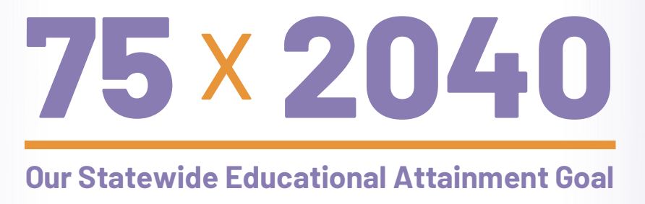
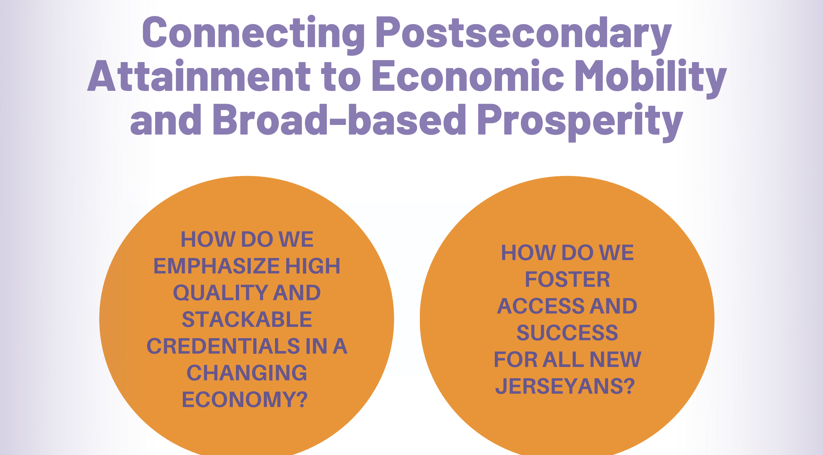



FUTURE READY NEW JERSEY COALITION

Slide 11
Attainment is NOT enough: some individuals with postsecondary degrees or credentials
are not earning enough to support a family.
The Lumina Foundation has developed a new refined measure that takes into account economic success.
GOAL 2040: By 2040, 75% of adults in the U.S. labor force (ages 25-64) will have college degrees or other credentials of value leading to economic prosperity.
Credentials of value lead to salaries and wages at least 15% above the national median earnings of a high school graduate.
Using this measure, as of 2023, 48.9% of New Jersey’s labor force met this goal. New Jersey ranked 9th among the 50 states, DC, and Puerto Rico, and was 4.8% higher than the national average of working adults with credentials of value.
#1
Washington DC
70.4%
States in the Northeast or Mid-Atlantic
#2
Massachusetts
53.2%
#3
Minnesota
50.7%
#4
Colorado
50.7%
Washington
49.8%
#5
#6
Connecticut
49.2%
#7
Virginia
49.2%
#8
Maryland
49.2%
#9
New Jersey
48.9%
Pennsylvania
43.1%
New York
46.3%
11

Slide 12
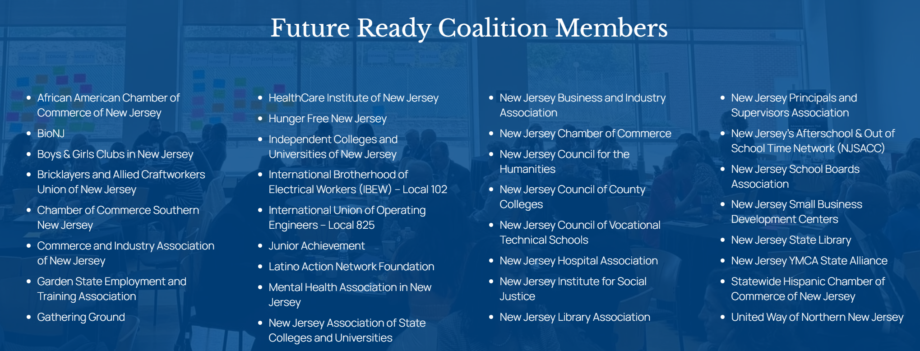


Slide 13
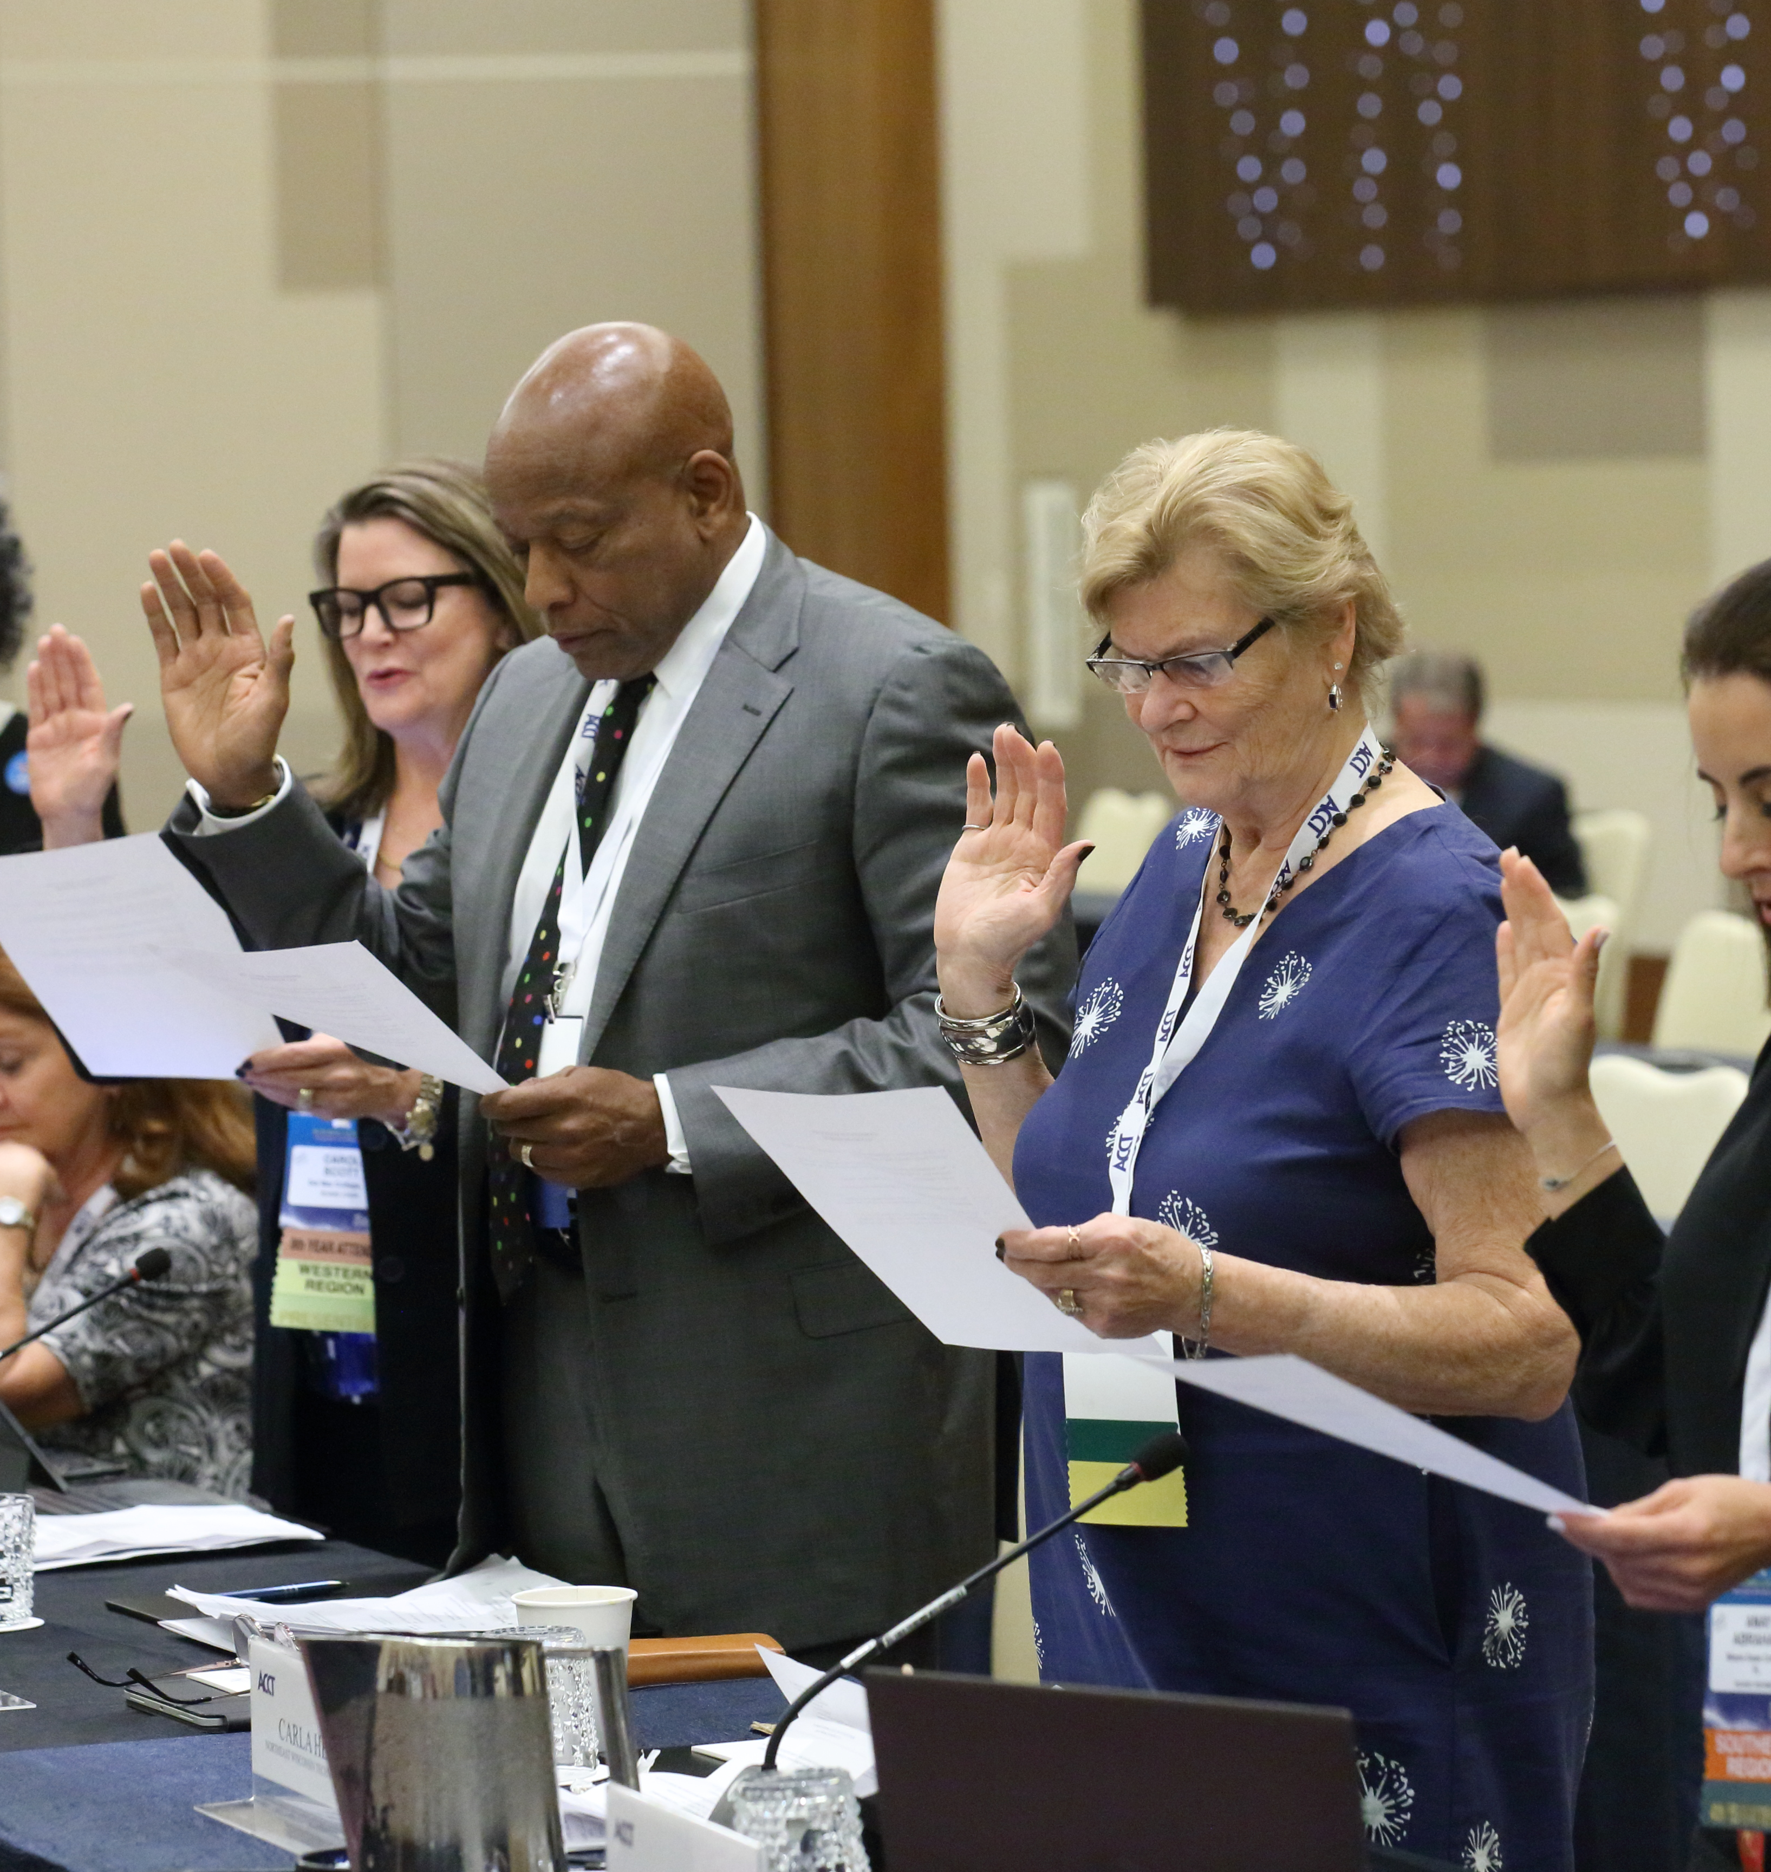
Effective Board Governance
Association of Community College Trustees
New Jersey Council
Of County Colleges
Monday, March 30, 2026
Tuesday, March 31, 2026
Facilitators:
Monday - Ken Burke, CPA
Tuesday – Mary Spilde, PhD
The Voice of Community College Trustees

Slide 14



Good Governance
Board’s power comes from acting as a team
No individual power
Paradox of hierarchy and partnership
Board and CEO on the same team
©ACCT 2024 | Please do not reproduce without permission.

Slide 15
Board Roles and Responsibilities
Board:
Leadership – tone setting and creating a climate
Direct through policy making and planning
Oversight/monitoring
Delegation
Support
Protect
Allocation of Resources
Advocacy
    President:
Administration
  Execution of policies and planning
  Management
  Day-to day operations
©ACCT 2024 | Please do not reproduce without permission.

Slide 16

Fiduciary Duties
Duty of Care - engagement, attendance, informed, strategic, monitor
Duty of Loyalty – operate in the interest of the college, and entire community -not a special interest
Duty of Obedience – follow state and federal laws, system and college policies, act within the scope of these documents
©ACCT 2024 | Please do not reproduce without permission.

Slide 17
Board’s Role
GOVERN THROUGH POLICY
Govern Through Policy
Govern as a whole body, not as an individual
Set a tone of respect and civility
Focus on listening to and learning from the external community
Exercise fiduciary responsibility –duty of care, duty of loyalty, duty of obedience
Focus on strategic planning and leadership
Focus on policy making, not administering – the what
Powerfully delegate
Publicly support the CEO
Hold the CEO accountable through monitoring
Provide a contract with the CEO
Hire and evaluate the CEO
Monitor successes & deficiencies of college
Know the financial status of the college
©ACCT 2024 | Please do not reproduce without permission.

Slide 18

RESPONSIBILITIES
Set standards through policy setting
Act as a unit with one voice –no power to act on own
Work as a member of the board team
Discourage partisan politics –allegiance to college not political party
Represent the public for whom they hold the college in trust
Govern transparently
Set the college’s strategic direction
Employ, evaluate and support the CEO
Set realistic goals in collaboration with the president
Define standards for quality and prudence through policy making
Assure fiscal health and stability through establishing policy standards for stewardship of public funds
Create a positive climate
Monitor institutional performance
Support and advocate for the college
Make board a priority- do homework, attend college events, be an ambassador
©ACCT 2024 | Please do not reproduce without permission.

Slide 19

Policy Categories
Outcome or Results Policies – (the “what”) defines what will be produced or offered, for whom and at what cost. Ends are not the services the college provides- they are the results of the services. The “means“ )the “how” by which these policies are achieved is the work of the administration, faculty and staff
Executive Limitations Policies define the boundaries or parameters for the President and employees within which the must work
Governance Process – roles and responsibilities of the board
Board-Staff Relationship Policies describe the delegation to and accountability of the CEO
©ACCT 2024 | Please do not reproduce without permission.

Slide 20
Board Power
The board’s power lies in its policy making role
If the board believes the college is moving in the wrong direction that can be rectified through developing new policy or adding executive limitations
©ACCT 2024 | Please do not reproduce without permission.

Slide 21
What is Governing through policy?
Three Principles:
Board decisions are predominantly policy decisions - Look at all issues through a policy lens (the “what”) leaving the “how” to administration
Policies are broad statements that set direction and standards for college operations
Boards define and delegate – identify the direction up-front and parameters within which the staff operates
©ACCT 2024 | Please do not reproduce without permission.

Slide 22

Board Role in Policy Making
Establish a thoughtful and public policy making process
Analyze policy proposals in light of ethical and legal standards
Assure multiple perspectives have been considered
Adopt broad policies that provide visionary direction and establish clear parameters
Monitor policy implementation
Ensure the policy is periodically reviewed and updated
Center policy making on creating positive impacts on students and the community

Slide 23
CEO’s Role in Policy Making
Help define and manage a thoughtful and public policymaking process
Provide policy analyses and present alternatives for board discussion
Alert the board to political ramifications of proposed policy alternatives
Provides information that enables the board to monitor policy implementation
Ensures the board regularly evaluates and updates its policies

Slide 24


SUMMARY
Policies are the voice of the board
They are living statements that frame the work of the board and the staff
Policies must be used by the board and staff – policy implications are discussed when issues are being explored
©ACCT 2024 | Please do not reproduce without permission.

Slide 25
GOVERNANCE
CONSULTATION
ADMINISTRATION
Statutory
Fiduciary
Policy Making
Direction
Delegation
Oversight/Monitoring
Support and Protection
Strategic Planning
Advocacy
Administration
Management
Day-to-day Guidance
©ACCT 2024 | Please do not reproduce without permission.

Slide 26
Board Role
Stay
Stay focused on the big picture – the “what”
Delegate
Delegate clearly and powerfully
Resist
Resist the temptation to prescribe staff means – the ”how”
Tell
Tell the CEO which means are unacceptable through policy – (policy making is board’s method of boundary setting)
Monitor
Monitor for accountability
Monitor
©ACCT 2024 | Please do not reproduce without permission.

Slide 27
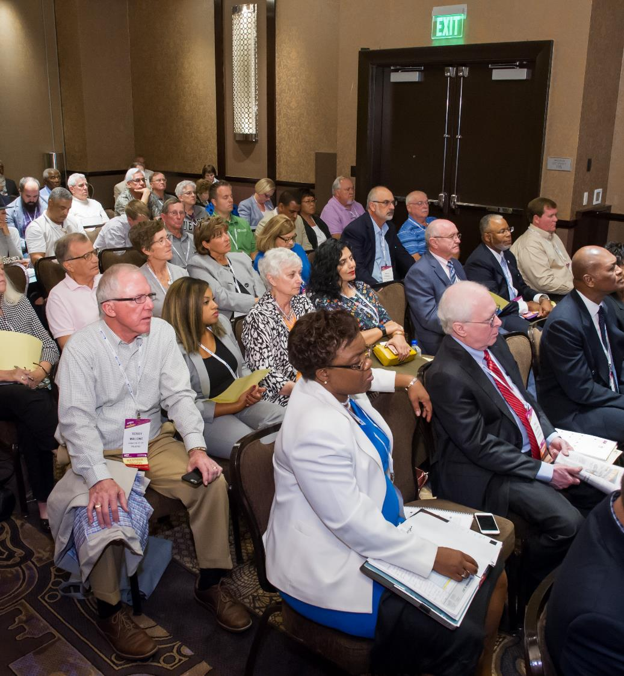
Set up for Success
Board and CEO on the same team
Good Board Governance
Effective Board/President Relations
Clear expectations and strategic priorities
Agreed upon evaluation system
Communication Protocols
Identifying what support looks like
©ACCT 2024 | Please do not reproduce without permission.

Slide 28
ESSENTIAL PRACTICES
Board Retreats at least annually – time for deeper and richer conversations about issues that matter
Annual Board Assessment resulting in Board Goals relating to board operations and behavior
Agreement on what constitutes a high performing board and a commitment to act in compliance with that agreement
Professional Learning for Trustees – local onboarding/orientation, state associations, ACCT
Take time to team build and get to know each other
Use tools such as agenda development that focuses the board on action
Study sessions (also called work sessions or conference sessions) where boards take a more in-depth look at issues e.g. student success, equity to provide shared and deeper understanding of the issues and the policy implications
Identifying a short set of high-level strategic priorities and expectations annually which constitutes the CEO’s work plan and upon which they will be evaluated
Development of trusting relationships among board members and with the CEO
Candid discussion and agreement on what reciprocal support looks like for individual board members, for president and for the board as a whole
©ACCT 2024 | Please do not reproduce without permission.

Slide 30
      New Jersey Community College Virtual Trustee Leadership Academy
      Review of NJ Laws & Requirements of Community College Governing Boards and its Members
      Requirements of the Senator Byron M. Baer Open Public Meetings Act
      Requirements of the Open Public Records Act (N.J.S. 47:1A-1 et seq.)
      Note: Your college’s counsel guides the efforts of your college to meet these legal requirements and can provide additional information as needed.
14

Slide 31
      New Jersey Community College Virtual Trustee Leadership Academy
      Review of NJ Laws & Requirements of Community College Governing Boards and its Members
      Requirements of the Senator Byron M. Baer Open Public Meetings Act
      N.J.S.A. 10:4-6. “Senator Byron M. Baer Open Public Meetings Act.”
      The Legislature finds and declares that the right of the public to be present at all meetings of public bodies, and to witness in full detail all phases of the deliberation, policy formulation, and decision making of public bodies, is vital to the enhancement and proper functioning of the democratic process; that secrecy in public affairs undermines the faith of the public in government and the public’s effectiveness in fulfilling its role in a democratic society, and hereby declares it to be the public policy of this State to insure the right of its citizens to have adequate advance notice of and the right to attend all meetings of public bodies at which any business affecting the public is discussed or acted upon in any way except only in those circumstances where otherwise the public interest would be clearly endangered or the personal privacy or guaranteed rights of individuals would be clearly in danger of unwarranted invasion.
15

Slide 32
      New Jersey Community College Virtual Trustee Leadership Academy
      Review of NJ Laws & Requirements of Community College Governing Boards and its Members
      Requirements of the Senator Byron M. Baer Open Public Meetings Act
      N.J.S.A. 10:4-6. “Senator Byron M. Baer Open Public Meetings Act.”
      “Meeting” means and includes any gathering whether corporeal or by means of communication equipment, which is attended by, or open to, all of the members of a public body, held with the intent, on the part of the members of the body present, to discuss or act as a unit upon the specific public business of that body.
      Meeting does not mean or include any such gathering:
      (1) attended by less than an effective majority of the members of a public body, or
      (2) attended by or open to all the members of three or more similar public bodies at a convention or similar gathering.
16

Slide 33

      New Jersey Community College Virtual Trustee Leadership Academy
      Review of NJ Laws & Requirements of Community College Governing Boards and its Members
      Requirements of the Senator Byron M. Baer Open Public Meetings Act
      N.J.S.A. 10:4-6. “Senator Byron M. Baer Open Public Meetings Act.”
      “Adequate notice” means written advance notice of at least 48 hours, giving the time, date, location and, to the extent known, the agenda of any regular, special or rescheduled meeting, which notice shall accurately state whether formal action may or may not be taken.
      Public entities must publish their legal notices on their website.
17

Slide 34
      New Jersey Community College Virtual Trustee Leadership Academy
      Review of NJ Laws & Requirements of Community College Governing Boards and its Members
      Requirements of the Open Public Records Act (N.J.S. 47:1A-1 et seq.)
      N.J.S. 47:1A-1 requires that:
      Government records must be readily accessible for inspection, copying, or examination by its citizens, with certain exceptions, for the protection of the public interest.
      Any limitations on the right of access to government records must be interpreted in favor of the public’s right of access.
      A public agency has a responsibility and an obligation to protect a citizen’s personal information that is in the possession of a public agency when disclosure of that information would violate the citizen’s reasonable expectation of privacy.
18

Slide 35

      New Jersey Community College Virtual Trustee Leadership Academy
      Review of NJ Laws & Requirements of Community College Governing Boards and its Members
      Requirements of the Open Public Records Act (N.J.S. 47:1A-1 et seq.)
      OPRA defines a “government record” as:
Any paper, written or printed book, document, drawing, map, plan, photograph, microfilm, data processed or image processed document, information stored or maintained electronically or by sound-recording or in a similar device, or any copy thereof, that has been made, maintained or kept on file . . . or that has been received in the course of his or its official business.
      Simply stated, a “government record” means any record that has been made, maintained, or kept on file, or that has been received in the course of official business.
19

Slide 36
      New Jersey Community College Virtual Trustee Leadership Academy
      Review of NJ Laws & Requirements of Community College Governing Boards and its Members
      Requirements of the Open Public Records Act (N.J.S. 47:1A-1 et seq.)
      OPRA allows for 40 exemptions, including most significantly:
      Privacy Interest - “a public agency has a responsibility and an obligation to safeguard from public access a citizen's personal information with which it has been entrusted when disclosure thereof would violate the citizen's reasonable expectation of privacy.”
      Inter-agency or intra-agency advisory, consultative or deliberative material.
20

Slide 37
      New Jersey Community College Virtual
      Trustee Leadership Academy
Council Meetings and Events for 2026
COUNCIL MEETINGS: QUARTERLY
    Monday, June 15, 2026, Virtual
    Monday, September 14, 2026, Middlesex College
    Monday, November 16, 2026, Middlesex College
NEW JERSEY COMMUNITY COLLEGE OPPORTUNITY SUMMIT
Atlantic City, NJ, June 9-11, 2026
37

Slide 38


Slide 39

New Jersey Trustees
March 31, 2026
Mary Spilde, PhD, Facilitator
The Voice of Community College Trustees

Slide 40









THREATS OR OPPORTUNITIES...
Rising Employee Expectations
Unbelievable Competition
Generative AI
Fungibility Threat
Political incursion
Welfare Agency?
Mental Health & Stress
New Administration

Slide 41

OUR CHANGED REALITY
The roles of community college trustees and presidents have become increasingly complex and challenging amid a shifting political and social landscape.
FOR TRUSTEES
Trustees now face heightened scrutiny as they navigate competing priorities, from maintaining fiscal responsibility to addressing workforce demands and ensuring services for all.
FOR CEOS
Presidents, meanwhile, must balance operational management, external advocacy, and strategic planning, often under intense public and board expectations.

Slide 42
OUR CHANGED REALITY
The stress dynamics between trustees and presidents can arise from differing governance philosophies, unclear role boundaries, or polarized political influences on institutional decisions.
FOR TRUSTEES
Trustees, often serving as unpaid volunteers, carry significant responsibility for decisions that shape the lives of students and communities, making their work both rewarding and fraught with pressure.
FOR CEOS
Navigating these challenges requires strong communication, mutual respect, and a shared commitment to the college's mission, ensuring both trustees and presidents can collaborate effectively for the college's success.

Slide 43
Set up for Success
Board and CEO on the same team
Good Board Governance
Effective Board/Chancellor Relations
Clear expectations and strategic priorities
Agreed upon evaluation system
Communication Protocols
Identifying what support looks like

Slide 44



Board – CEO Relationship

Slide 45
Governance Consultation Administration
Statutory
Fiduciary
Policy Making
Direction
Delegation
Oversight/monitoring
Support and Protection
Strategic Planning
Advocacy
Policy Making
Administration
Management
Day-to-day guidance

Slide 46




GOVERNANCE
IT'S A PROCESS BY WHICH AN ELECTED/APPOINTED BODY DECLARES ITS PRIORITIES AND EXPECTATIONS BY PROVIDING CLEAR DIRECTION, THROUGH ADOPTED POLICIES, WHICH ARE IN THE PUBLIC INTEREST, AND FOR WHICH THEIR SOLE EMPLOYEE - THE EXECUTIVE, AND THE BOARD ARE ACCOUNTABLE.
Daniel J. Phelan
2020

Slide 47

EXECUTIVE ADMINISTRATION
AS THE INSTITUTION'S STRATEGIC LEADER, THE CEO IS RESPONSIBLE FOR SETTING AND EXECUTING ITS VISION AND OBJECTIVES, OVERSEEING ALL OPERATIONS, ENSURING COMPLIANCE, AND CULTIVATING AN INCLUSIVE CULTURE. THE CEO PROVIDES POLICY AND GOVERNANCE GUIDANCE, ALIGNING INSTITUTIONAL STRATEGIES WITH COMMUNITY AND WORKFORCE DEMANDS.
Daniel J. Phelan
2024

Slide 48

THE BOARD AND CEO PARTNERSHIP
THE BOARD OF TRUSTEES AND THE CEO OF A COMMUNITY COLLEGE MUST WORK AS A COHESIVE TEAM, COMBINING THE BOARD’S STRATEGIC DIRECTION WITH THE CEO’S LEADERSHIP AND MANAGEMENT. THROUGH TRUST, OPEN COMMUNICATION, AND RESPECT FOR ROLES, THEY ALIGN EFFORTS TO ADVANCE STUDENT SUCCESS, BUILD COMMUNITY PARTNERSHIPS, AND ACHIEVE INSTITUTIONAL EXCELLENCE.

Slide 49
CEO’s Role
Respect the Board and its role
Listen
Engage the board in policy level discussions
Make recommendations that include analysis and options
Publicly support the board
Adhere to board policy
Facilitate trustee involvement in community and college
Do not ask to make decisions without advance preparation
Provide all board members with same information
Treat all equally
Respect time
Stay out of board politics
Keep Board informed of financial condition of college
Manage/administer all aspects of the operations of the college within policy framework

Slide 50
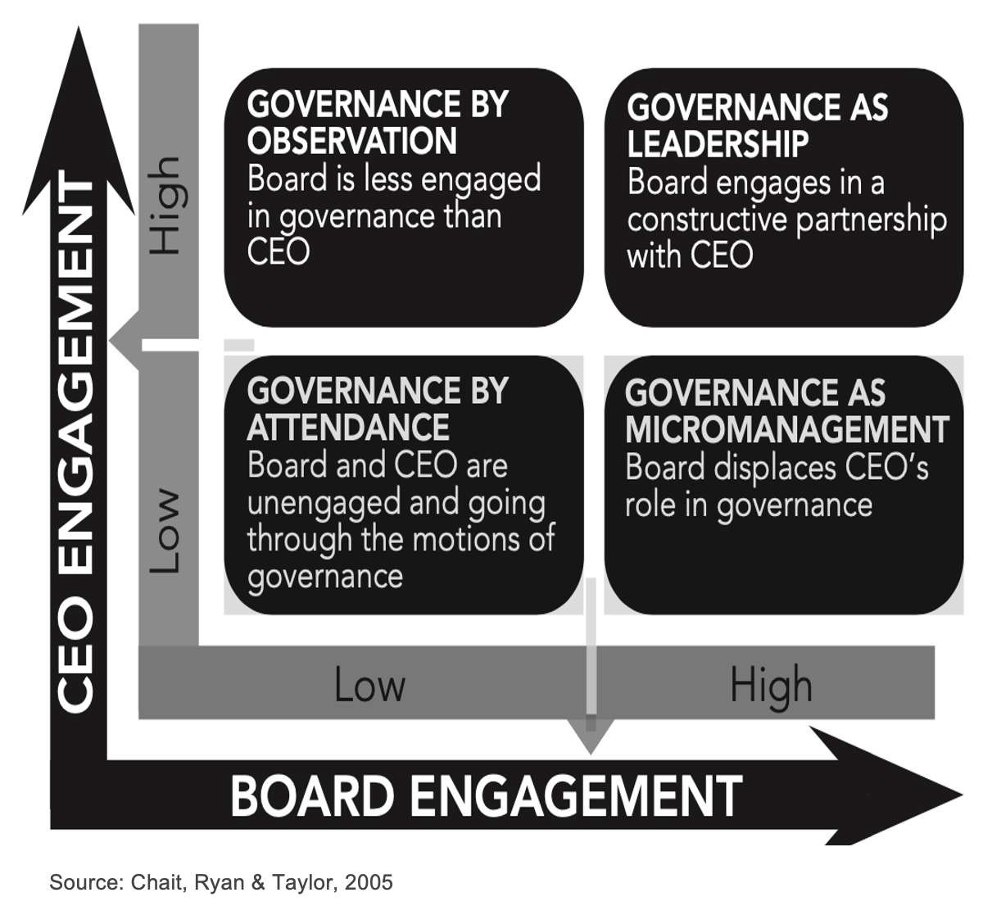
IDEALLY,
HOW SHOULD
THIS WORK?

Slide 51
Trustee Swim Lane
Board Policy Development
Policy Driven Governance/Decision making
Establishing Strategic Direction
Financial Oversight
CEO Selection and Evaluation
Fiduciary responsibility - Care, Loyalty, Obedience, Stewardship
Responsible to public owners
Set the tone
Chair represents Board to public
Delegates to CEO only
Never surprise the CEO – heads up on questions
Strong communication to CEO
Does not micromanage the CEO
Performance monitoring of CEO
Notifies CEO if contacted by employees and/or on campus
Engages in continual professional development
Engages in goal-based self evaluation
Collaborate to set Board goals
Focus on Board goals
CEO Swim Lane
Organizational policy development
Operational decision making
Establishing and leading the Strategic Plan
Financial Management to achieve objectives
Employee selection and evaluation
Responsible for risk and transparency of work
Responsible to Board as a body
Set the tone
CEO represents college to the public
Carries out Board directives and related work
Strong communication to Board- Never surprise the Board
Never manages upward to Board– advisor, resource
Evaluated according to policy/desired outcomes/goals
Establishes robust shared governance/input processes
Engages in professional learning
Provides reasonable progress data to Board
Notifies the Board on urgent matters of impact
Keeps Board informed of significant or changing issues
Focuses on college goals in alignment with strategic plan
Collaborates to create agenda

Slide 52
1
Foster Open Communication:
Keep the board informed with regular updates on institutional performance, challenges, and opportunities, ensuring transparency and building trust.
2
Respect Governance Roles:
Honor the board’s authority in policy-making and strategic oversight, while clearly defining and maintaining the CEO’s operational leadership responsibilities.
3
Seek and Value Input:
Actively listen to the board’s perspectives and incorporate their guidance into decision-making, demonstrating respect for their expertise and role.
4
Provide Strategic Leadership:
Present well-researched recommendations and actionable plans that align with the college’s mission and the board’s strategic goals, positioning the institution for success.
5
Be Accountable:
Deliver results aligned with the board’s vision, sharing progress through regular performance reports and being responsive to constructive feedback.
6
Engage in Professionalism and Trust- Building:
Cultivate a respectful, collaborative relationship with trustees, ensuring that mutual respect and shared commitment drive the partnership.
President's Commitments for a Solid Partnership in 6 Ways

Slide 53
1
Establish Clear Roles and Boundaries:
Trustees should focus on governance and policy- making, leaving operational and management responsibilities to the CEO, while supporting their leadership.
2
Maintain Open and Regular Communication:
Foster transparency and trust through frequent, respectful dialogue with the CEO, ensuring alignment on Board goals and priorities.
3
Provide Constructive Feedback:
Offer regular guidance and evaluation based on performance metrics and mutual goals, delivering constructive input that supports the CEO’s growth and effectiveness.
4
Offer Advocacy and Support:
Actively advocate for the college in the community, with legislators, and among stakeholders, reinforcing the CEO’s efforts to secure resources and build partnerships.
5
Demonstrate Trust and Confidence:
Empower the CEO to make decisions and implement the board’s vision without micromanaging, showing confidence in their expertise and leadership.
6
Commit to Professional Development:
Engage in training and learning opportunities that strengthen the board’s understanding of effective governance and support a productive partnership with the CEO.
Board Commitments for a Solid Partnership in 6 Ways

Slide 54
Board-CEO Partnership
Communication
Open, appropriate and even-handed
Explore issues to achieve mutual understanding
Provide the board with comprehensive, relevant, timely information (clarify what information is needed to inform board’s decision making)
Establish protocol for connecting with internal stakeholders
Share concerns with the CEO
No surprises
Sounding board
Exhibit mutual respect and support

Slide 55
Communication
Board communicates all requests for information through the CEO/chair
Communication with individual employees/groups must begin with the Board Member indicating that any information shared will be shared with the CEO
The CEO must communicate (and not just good news) to the board

Slide 56
What does it look like on the ground?
Clarity, clarity, clarity
A trusting relationship among board members and with the CEO
Vigorous debate…but once vote taken -speak with one voice
Enhanced dialogue, consultation, advice seeking and giving

Slide 57
Board and CEO Role in Policy Development
Policy making is a joint effort between the Board and the CEO
Establishment of of a systematic approach that defines roles and responsibilities of stakeholders, the steps in the process to create a policy and how the policy will be monitored
Know the difference between policy and operations

Slide 58
CEO’s Role in Policy Making
Help define and manage a thoughtful and public policymaking process
Provide policy analyses and present alternatives for board discussion
Alert the board to political ramifications of proposed policy alternatives
Provides information that enables the board to monitor policy implementation
Ensures the board regularly evaluates and updates its policies

Slide 59
ESSENTIAL PRACTICES
Board Retreats at least annually – time for deeper and richer conversations about issues that matter
Annual Board Assessment resulting in Board Goals relating to board operations and behavior
Agreement on what constitutes a high performing board and a commitment to act in compliance with that agreement
Professional Learning for Trustees – local onboarding/orientation, state associations, ACCT
Take time to team build and get to know each other
Use tools such as agenda development that focuses the board on action
Study sessions (also called work sessions or conference sessions) where boards take a more in-depth look at issues e.g. student success, equity to provide shared and deeper understanding of the issues and the policy implications
Identifying a short set of high-level strategic priorities and expectations annually which constitutes the CEO’s work plan and upon which they will be evaluated
Development of trusting relationships among board members and with the CEO
Candid discussion and agreement on what reciprocal support looks like for individual board members, for president and for the board as a whole

Slide 60
The Board and Accreditation Standards – an example
An accredited institution possesses and demonstrates the following attributes or activities:
1. a clearly articulated and transparent governance structure that outlines roles, responsibilities, and accountability for decision making by each constituency, including governing body, administration, faculty, staff and students;
2. a legally constituted governing body that:
a. serves the public interest, ensures that the institution clearly states and fulfills its mission and goals, has fiduciary responsibility for the institution, and is ultimately accountable for the academic quality, planning, and fiscal well-being of the institution;
b. has sufficient independence and expertise to ensure the integrity of the institution. Members must have primary responsibility to the accredited institution and not allow political, financial, or other influences to interfere with their governing responsibilities;
c. ensures that neither the governing body nor its individual members interferes in the day-to-day operations of the institution;
d. oversees at the policy level the quality of teaching and learning, the approval of degree programs and the awarding of degrees, the establishment of personnel policies and procedures, the approval of policies and by-laws, and the assurance of strong fiscal management;
e. plays a basic policy-making role in financial affairs to ensure integrity and strong financial management. This may include a timely review of audited financial statements and/or other documents related to the fiscal viability of the institution;
f. appoints and regularly evaluates the performance of the Chief Executive Officer
                --Middle States Commission on Higher Education

Slide 61
Case Studies
Room 1 – Case Study 5 - College in Need of Improvement
Room 2 – Case Study 6 – individual Trustee Request for Information
Room 3 – Case Study 7 – No Surprises Rule
Room 4 – Case Study 8 – A Divided Board and More

Slide 62

PROTECTING THE WELLBEING OF
YOUR CEO
Hiring a president is the most significant investment a board can make for its college. Trustees need to ensure they are supported.
By George R. Boggs, Ph.D., and Maria Sheehan, Ed.D.

Slide 63

The voice of community college leaders.
Contact Us
Email:
Phone:
Website:
acctinfo@acct.org
202-775-4667
www.acct.org

