Slide 1
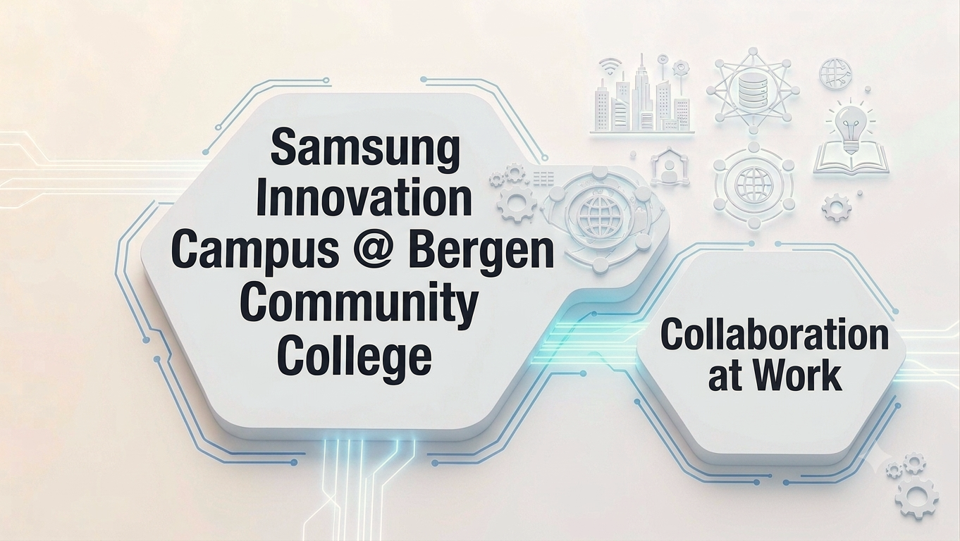

Dr. Emily Vandalovsky
Dean of STEM Division
Bergen Community College
June 10, 2026

Slide 2
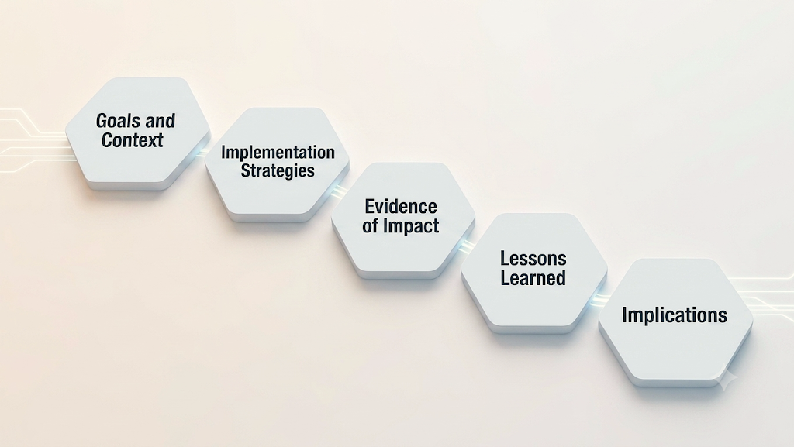
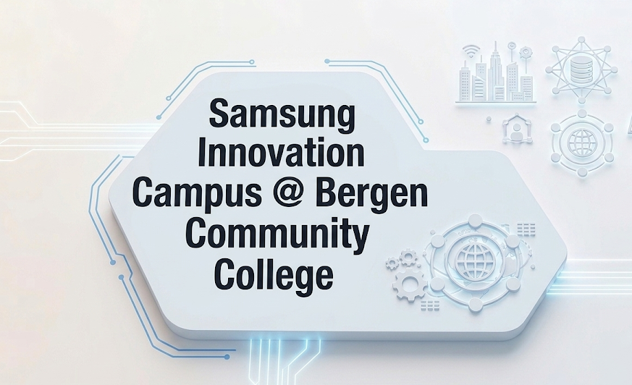

Slide 3

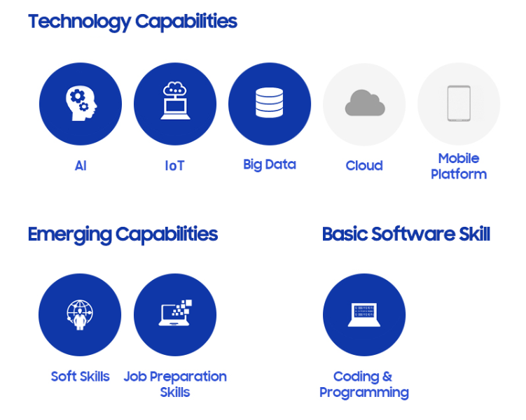
Context:
  Samsung Electronics America sought to expand its social responsibility footprint by empowering students with entry-level proficiency in emerging technologies.
  BCC embraced the opportunity to deliver specialized technical training that carries weight in the corporate sector.
Primary Goals:
  Equip students with marketable technical skills in Python, algorithms, and software development.
  Bridge the gap between academic environment and real-world corporate setting.
  Foster professional identity through direct engagement with industry partners.
Image source: https://img.us.news.samsung.com/us/wp-content/uploads/2022/11/29173526/SIC-NWSRM-Body-Image-1000-x-600.png

Slide 4
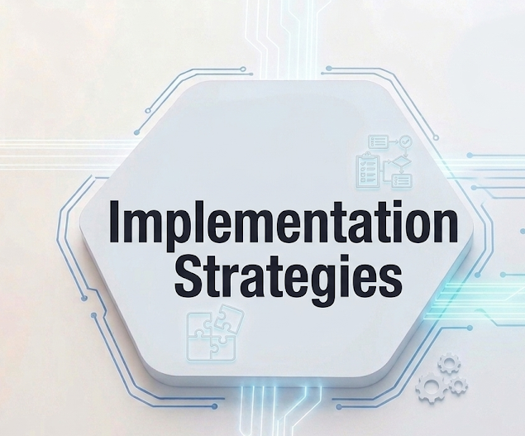
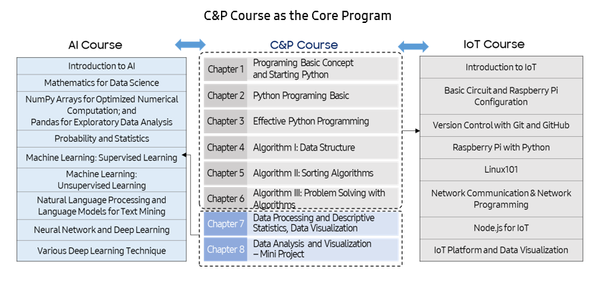

Curricular Integration
- Samsung Electronics America provided access to materials.
- BCC team evaluated materials and selected Coding and Programming (C&P) course.

Slide 5
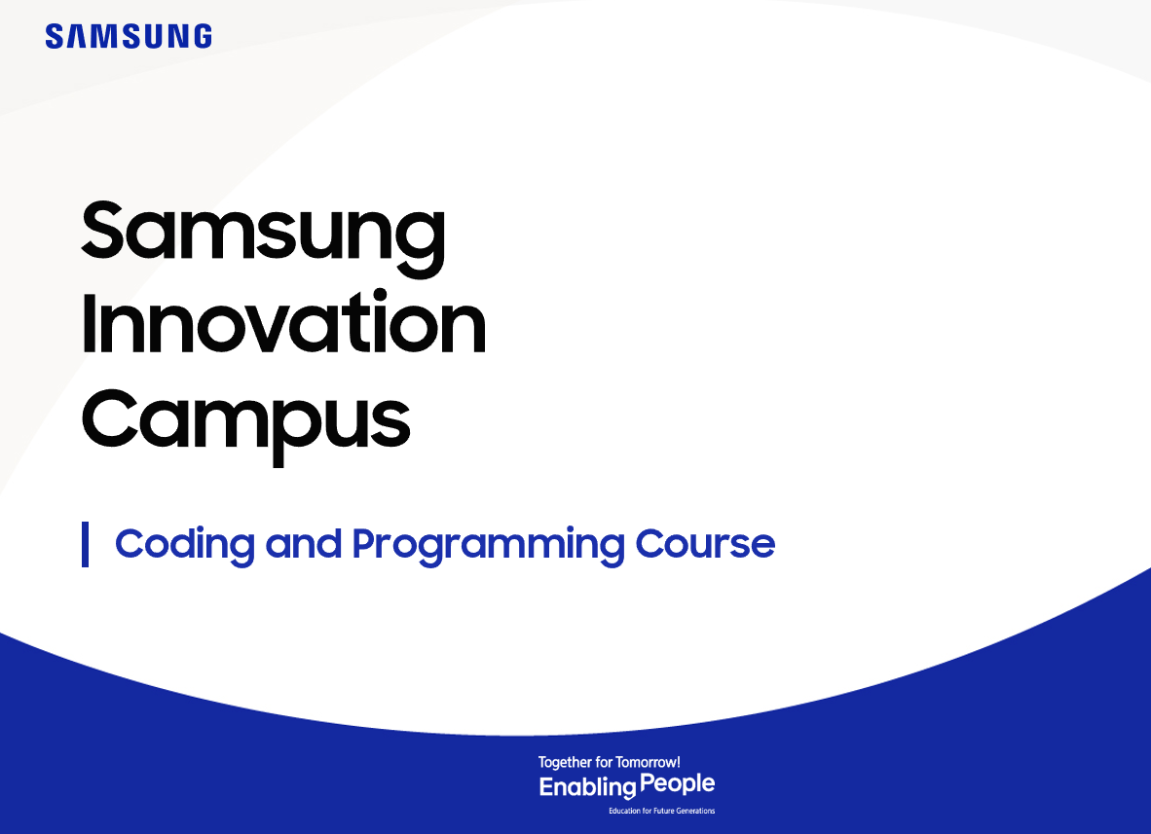



Curricular Integration (Cont.)
- Bergen faculty team assessed the C&P course content through the lens of the college curriculum.
- The team adjusted the existing 100-level course and created a pilot 200-level course.
PART 1:
Adjusted existing 100-level Introduction to Programming
Using Python course
PART 2:
Developed and launched pilot 200-level Intermediate Python course

Slide 6
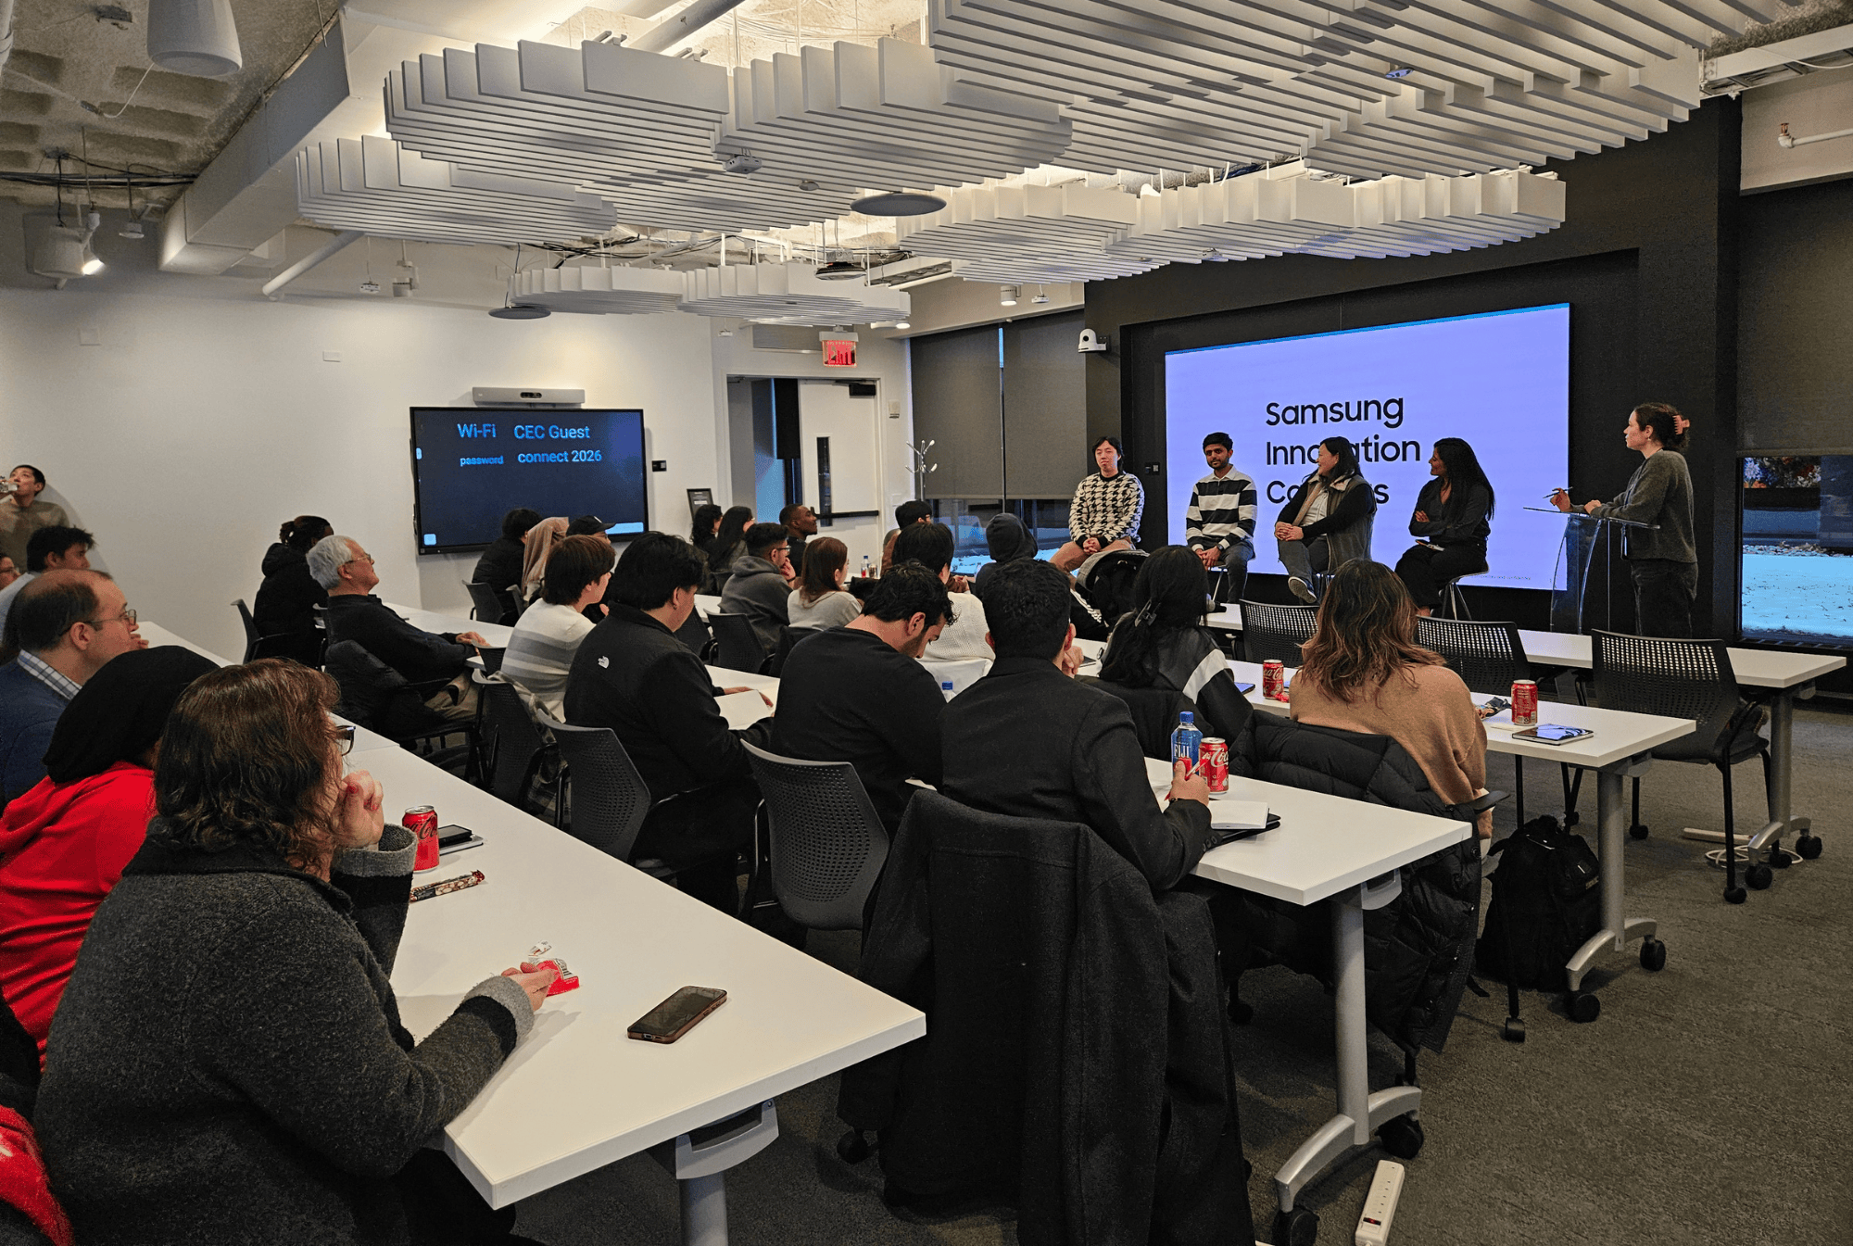
Experiential Learning:
Students and faculty were invited to a site visit at Samsung Electronics America.
Image source: https://img.us.news.samsung.com/us/wp-content/uploads/2026/04/21112841/Untitled-design-71.png

Slide 7
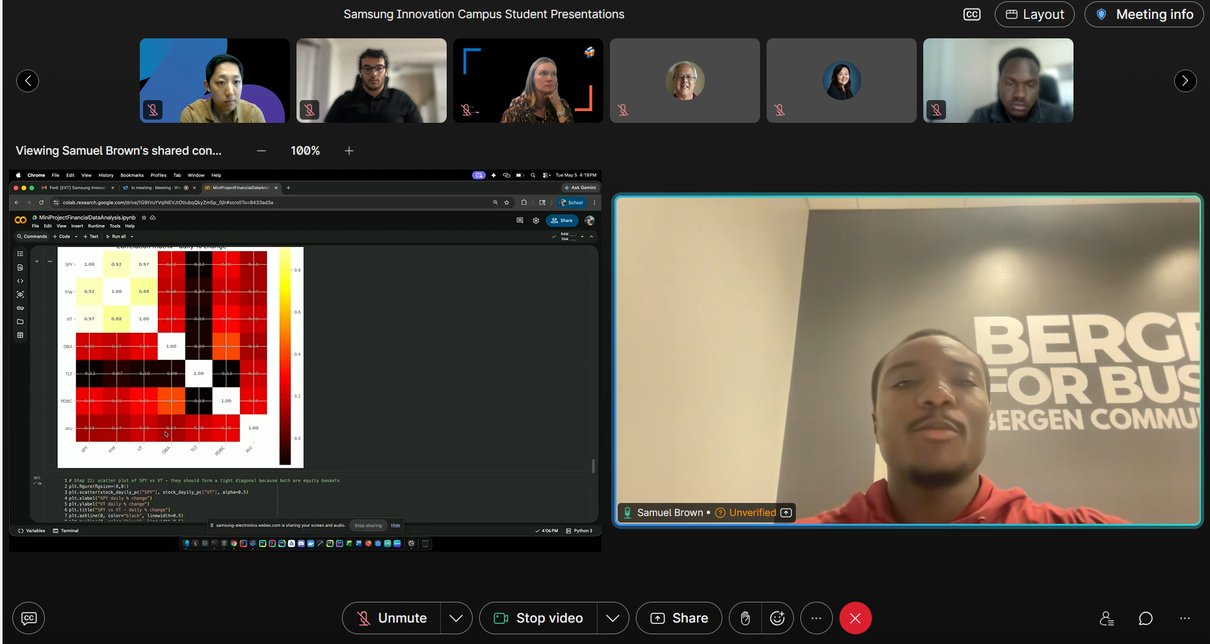
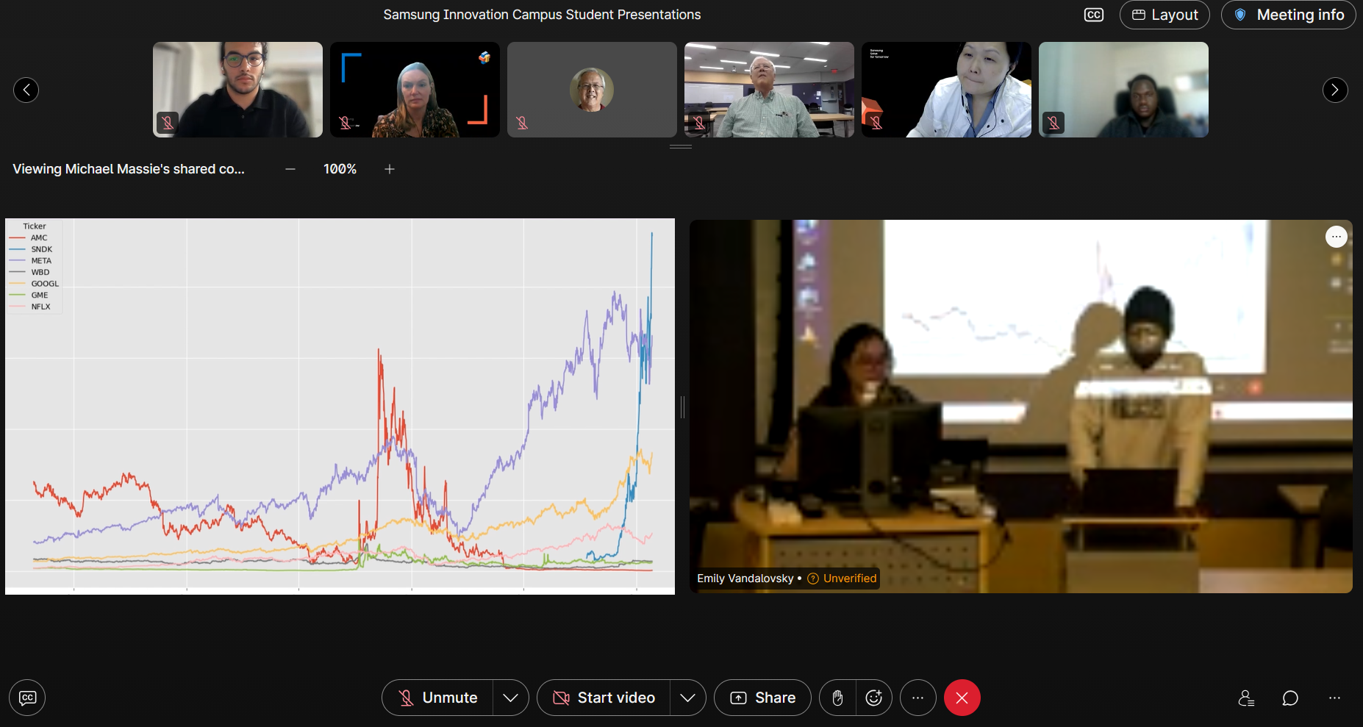
Experiential Learning (Cont.):
At the end of the two-semester sequence,
students presented their final projects
to Samsung employees.

Slide 8
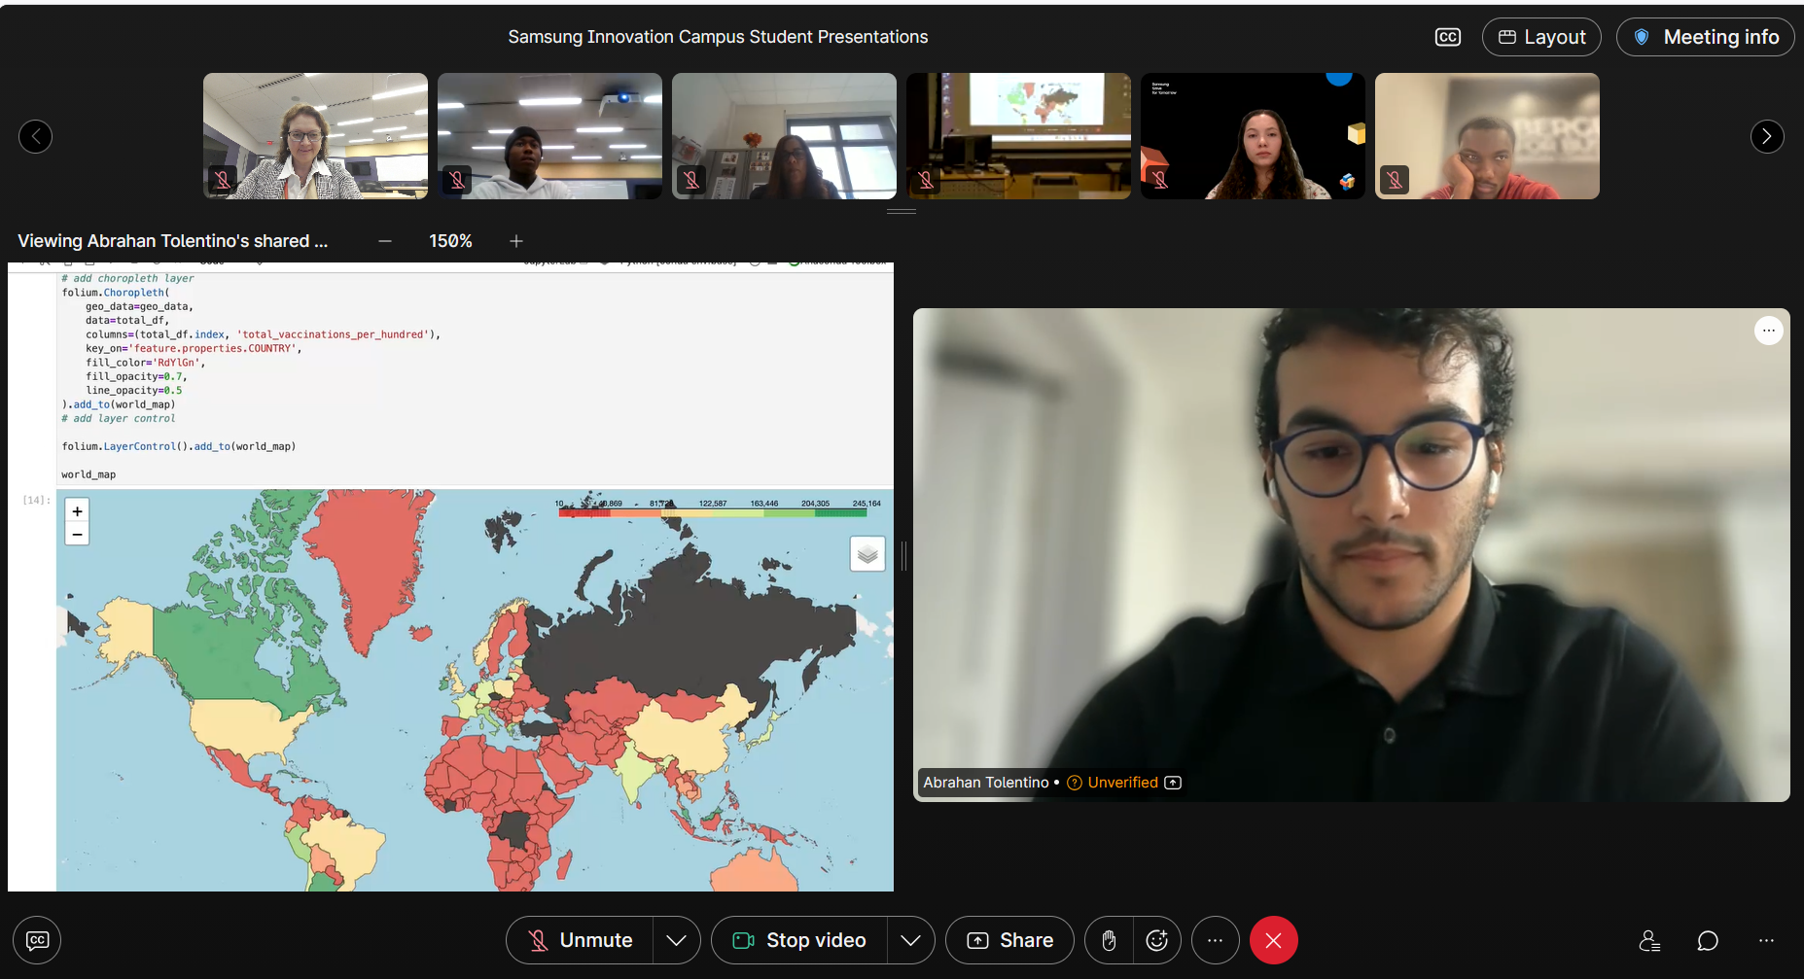
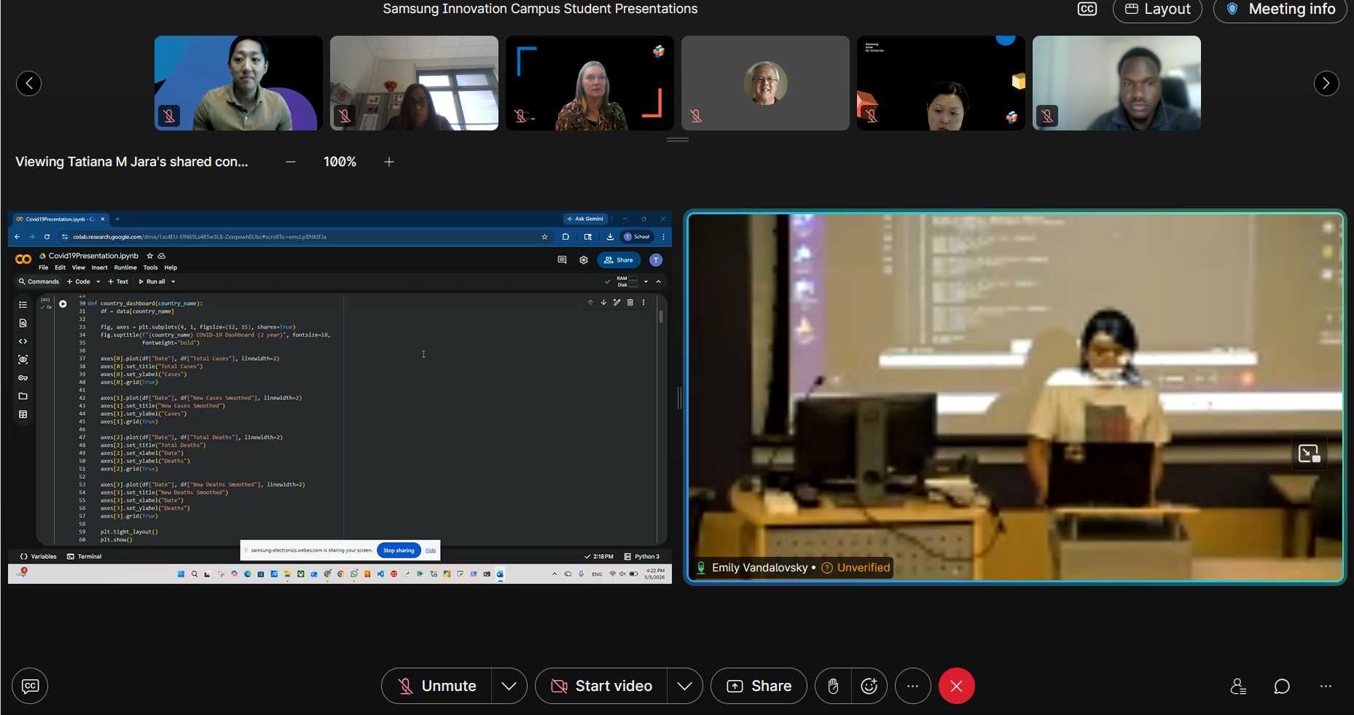
Experiential Learning (Cont.):
As per course requirements, students created a project employing data analysis and visualization tools.

Slide 9
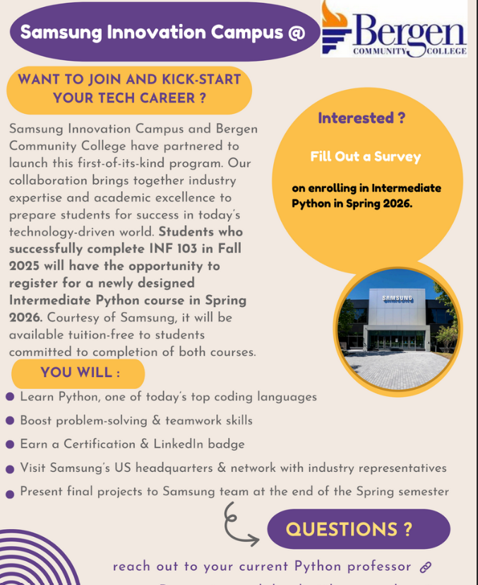
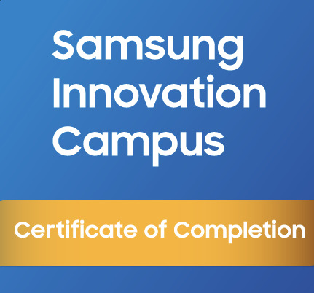
Professional Branding:
The program integrated LinkedIn badges as a
micro-credentialing strategy, allowing students to instantly signal their new skills to recruiters.
Financial Support and
Student Recruitment:
Students received financial support for a 2-semester course sequence. It helped with recruitment efforts.

Slide 10
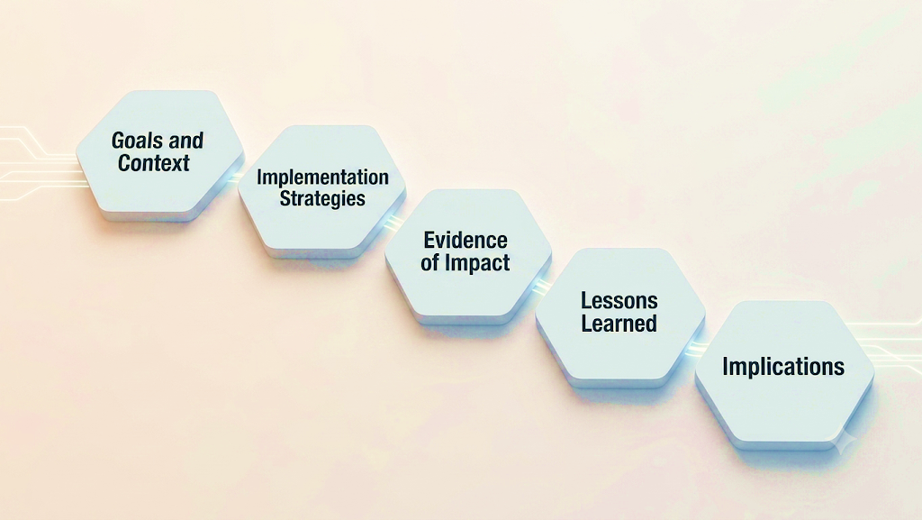
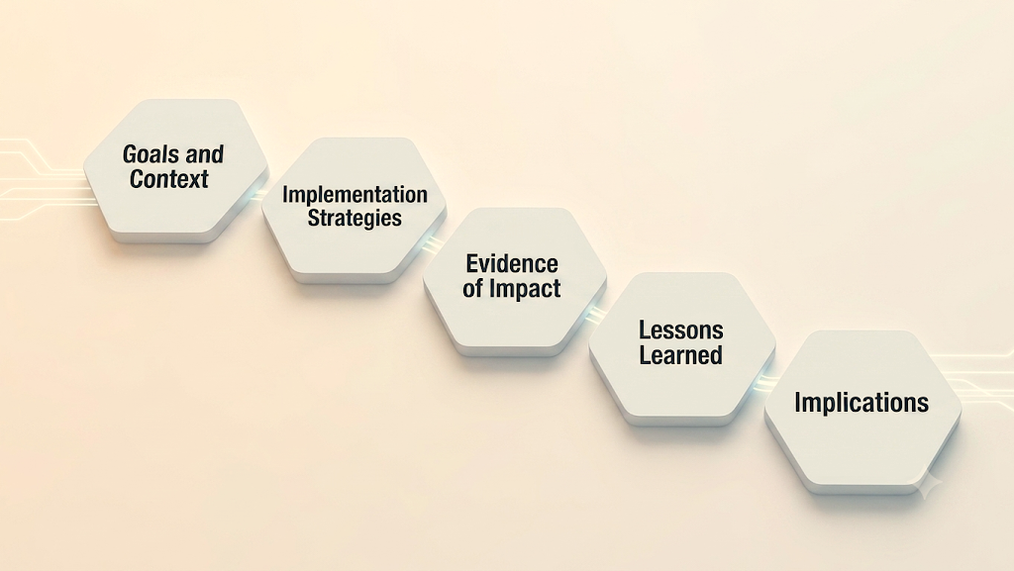

Slide 11

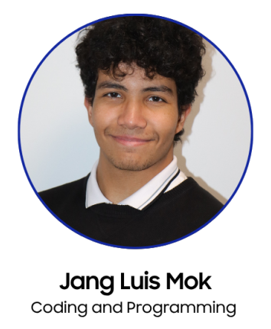
Connection between Industry and Academia
Samsung expanded its social responsibility footprint by supporting the students in gaining technical proficiency and confidence.
BCC validated relevance and impact of instruction.
“When this opportunity came up I took it without any doubt in my mind. I felt like this moment was the one I could have to learn more about programming… Many of my classmates are on the same boat as me. We all try our best to learn this topic and also to help each other no matter what.” (Jang Luis Mok, BCC student)
Student Success
Students worked collaboratively through the program to gain technical skills.
Career Readiness: students earned an industry-recognized LinkedIn badge which reinforced their resume as more competitive.
Enhanced Social Capital: students reported increased interest in learning and gained confidence after connecting with Samsung employees during the site visit and final presentations.
Image source: https://img.us.news.samsung.com/us/wp-content/uploads/2026/04/21103633/Subtitle-950x497.png

Slide 12
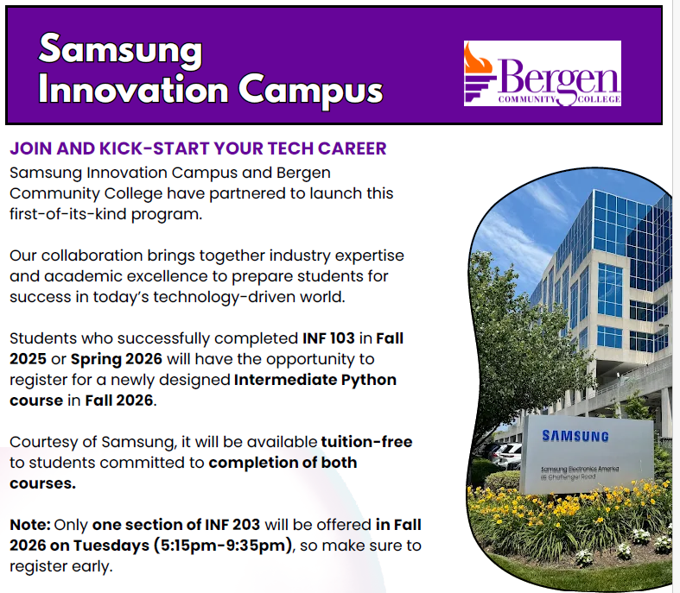
  Faculty Participation is Key:
  Success depends on faculty who are willing to adapt their teaching styles to incorporate third-party industry content employ their teaching skills and methodologies to deliver industry-designed content through academically viable formats.
  Innovation Mindset:
  Ability to adjust the existing curriculum, adopt and pilot new curriculum in a short period of time allowed for pedagogical innovation and discovery (aka bravery ☺).
  Internal Support and Collaboration:
  Multiple Bergen teams supported the academic division in accomplishing this goal.
  Exposure Matters as Much as Code:
  The technical skills were vital, but direct contact with Samsung employees was the "anchor" that linked students to the industry.
  Financial Benefit:
  Students received financial support for a 2-semester course.
Lessons Learned

Slide 13


Implications
Implications
  Corporate-Academic Synergy:
  Community colleges are uniquely positioned to act as the workforce engine for industry partners (flexibility, adaptability, innovation).
  Standardization:
  Using an industry-designed curriculum (like C&P) ensures that students are learning a standardized set of competencies recognized by global employers.
  Beyond the Degree:
  Micro-credentials (badges) are increasingly becoming the currency of the modern job market; community colleges lead the way in integrating them.

Slide 14

References:
Questions / Comments:
Emily Vandalovsky
evandalovsky@bergen.edu
Bergen Community College
Dean of STEM Division
Samsung Electronics America. (2022, November 30). Samsung Innovation Campus AI course empowers communities through education. Samsung US Newsroom. https://news.samsung.com/us/samsung-innovation-campus-ai-course-empowers-communities-education/
Samsung Electronics America. (2026, April 21). Samsung Innovation Campus Learner Spotlight: How Jang Luis Mok found a gateway to a tech career. Samsung US Newsroom. https://news.samsung.com/us/samsung-innovation-campus-learner-spotlight-jang-mok/

